Slide 1
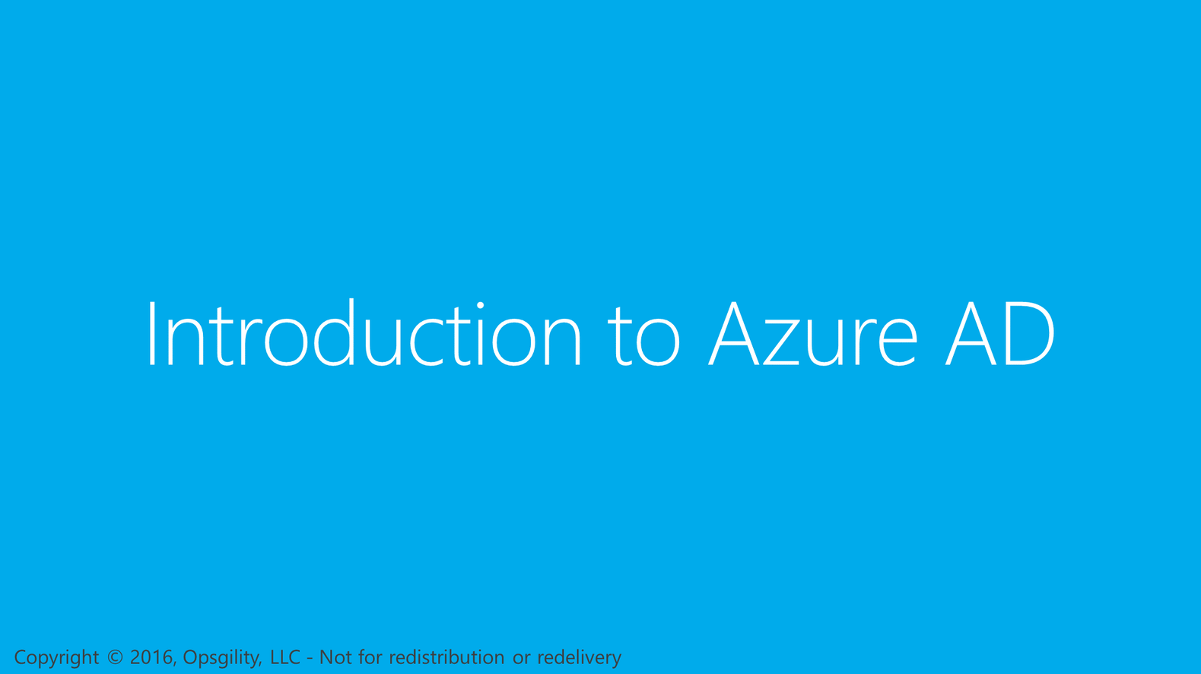
Introduction to Azure AD
Notes:
So let’s begin with an introduction to Microsoft Azure Active Directory.

Slide 2
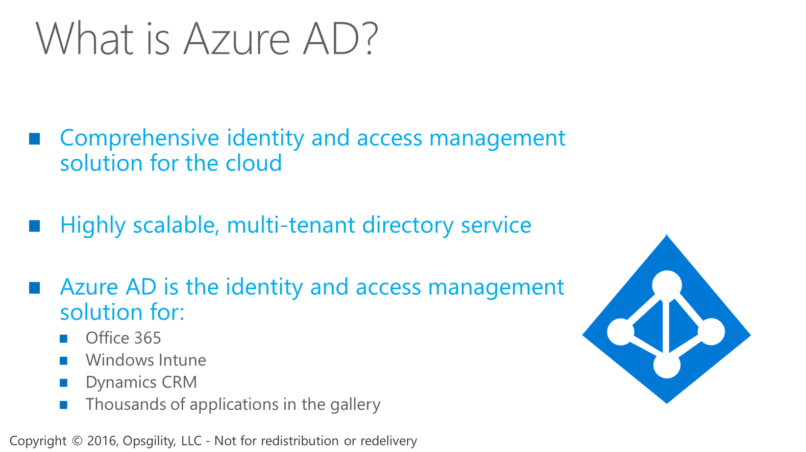

What is Azure AD?

Slide 3
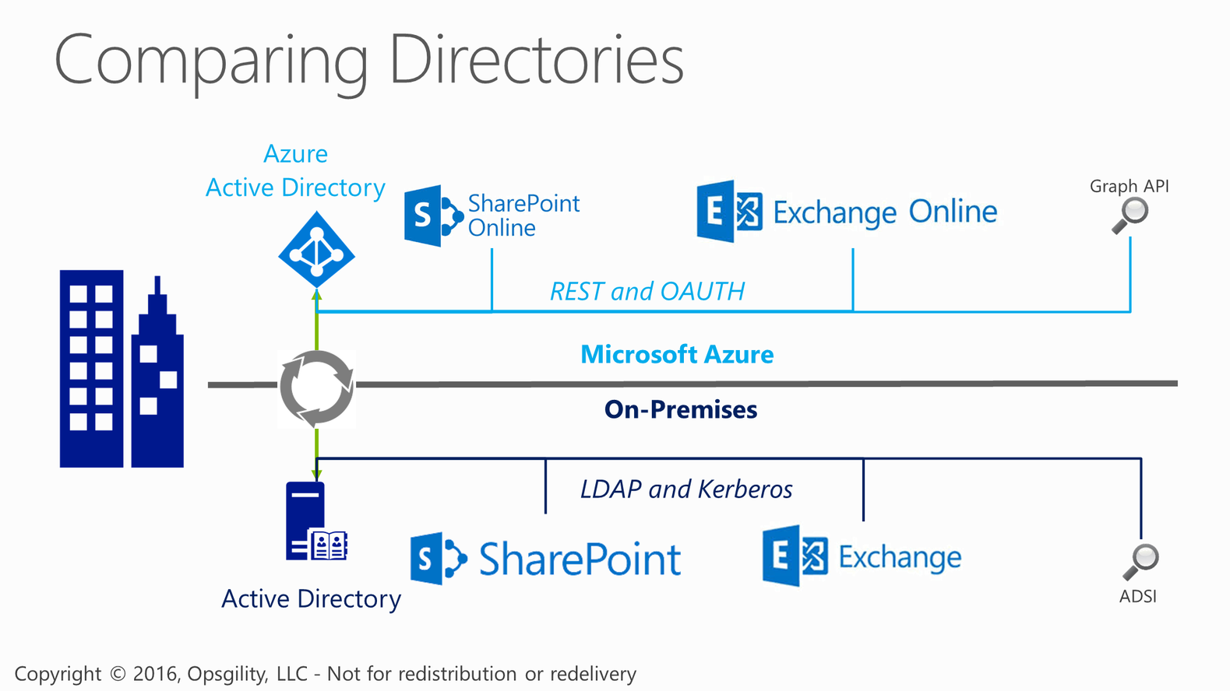
Comparing Directories

Slide 4
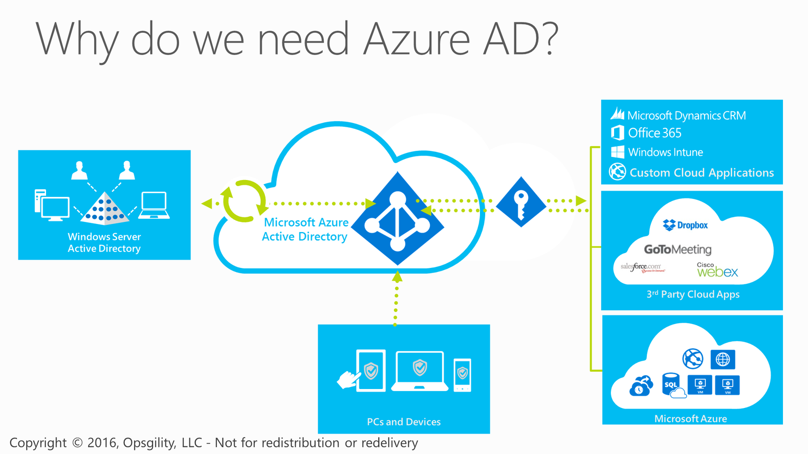
Why do we need Azure AD?
Notes:
The identity for a user is one that can exist in your on-premises Active Directory and your Azure Active Directory. And while the two certainly can be managed independently of each other, it is not a requirement that you do so. For organizations that do not have an on-premises directory, Azure Active Directory can be the sole directory.
<CLICK>
Having said that, in a hybrid world where user identities are managed on-premises with Windows Server AD, that active directory can be extended to Azure AD.
<CLICK>
By doing this, users can access cloud applications using the same identity they use when accessing applications on-premises.
<CLICK>
As users move from the on-premises environment to environments where they may use a different computer (at home for example), or other devices such as a mobile phone, they can still access the LOB applications they need through Azure AD using their on-premises credentials.
<CLICK>
It is also becoming increasingly common for users who are not part of an organization’s on-premises directory to still be provisioned to access applications owned by the organization. For example, in a freelance type of scenario with someone working on a short term project. In these cases, you can integrate these users into the Azure AD using their identity from a social identity provider such as a Microsoft Account, Google, Facebook, or Twitter, and then provision their account to access applications as appropriate.

Slide 5
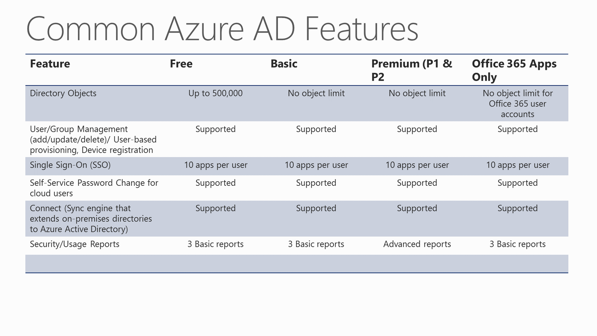
Common Azure AD Features
Notes:
FREE SKU is what you get by default
BASIC and PREMIUM can only be purchased through an EA.
http://azure.microsoft.com/en-us/pricing/details/active-directory/

Slide 6
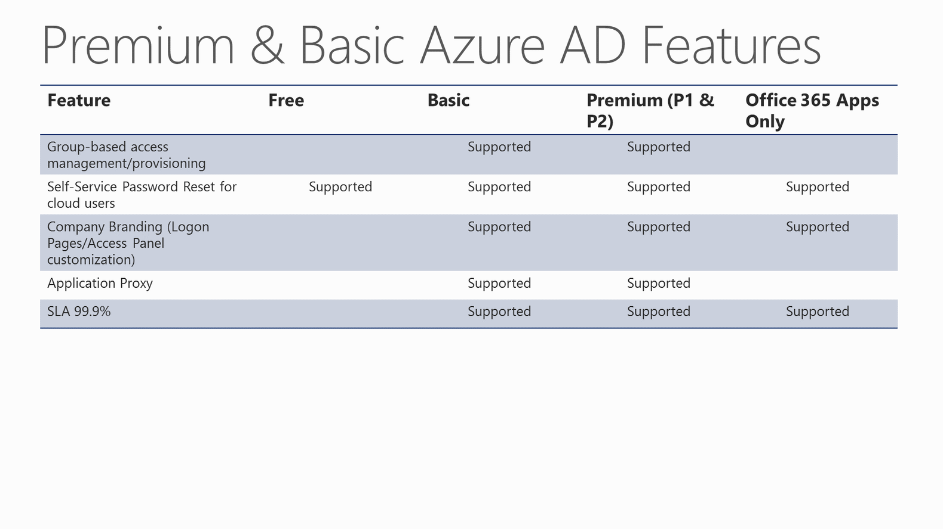
Premium & Basic Azure AD Features
Notes:
FREE SKU is what you get by default
BASIC and PREMIUM can only be purchased through an EA.
http://azure.microsoft.com/en-us/pricing/details/active-directory/

Slide 7
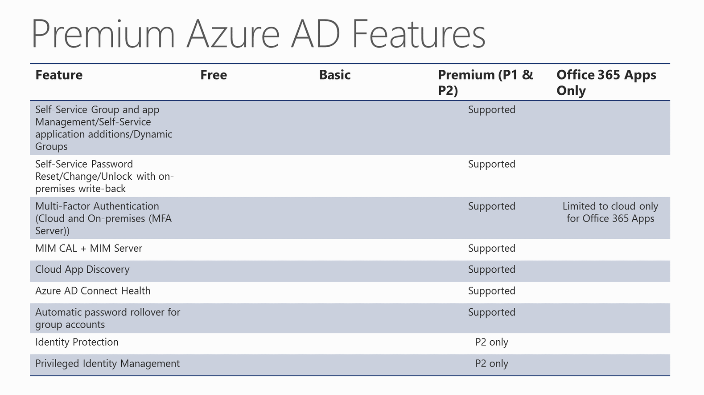
Premium Azure AD Features
Notes:
FREE SKU is what you get by default
BASIC and PREMIUM can only be purchased through an EA.
http://azure.microsoft.com/en-us/pricing/details/active-directory/

Slide 8
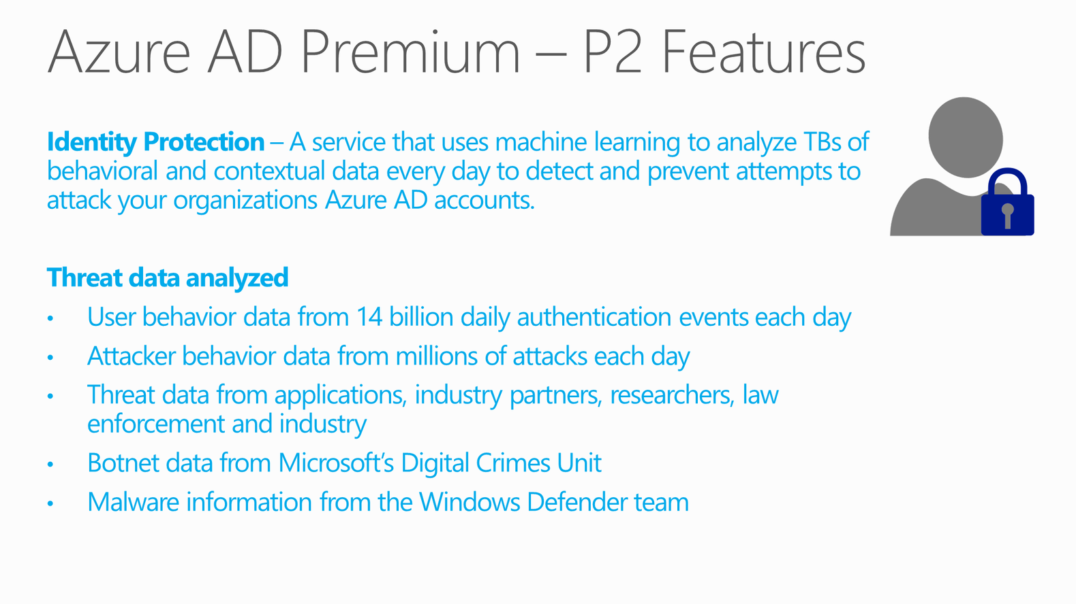
Azure AD Premium – P2 Features

Slide 9
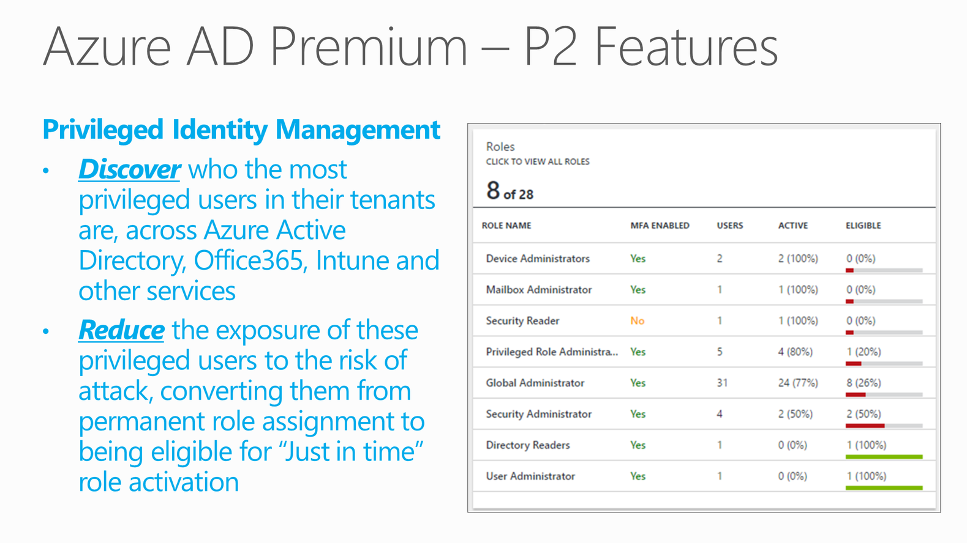
Azure AD Premium – P2 Features

Slide 10
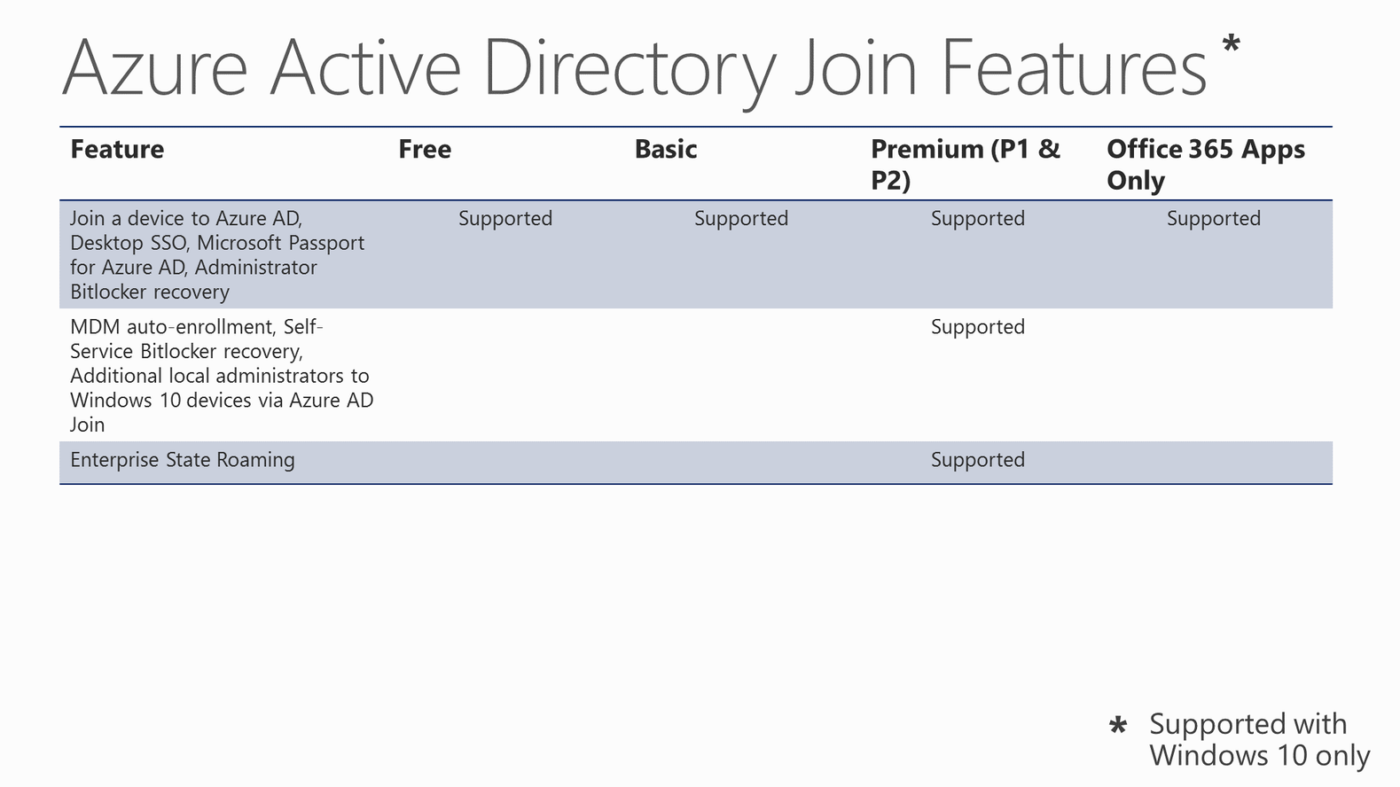
Azure Active Directory Join Features
Notes:
FREE SKU is what you get by default
BASIC and PREMIUM can only be purchased through an EA.
http://azure.microsoft.com/en-us/pricing/details/active-directory/

Slide 11
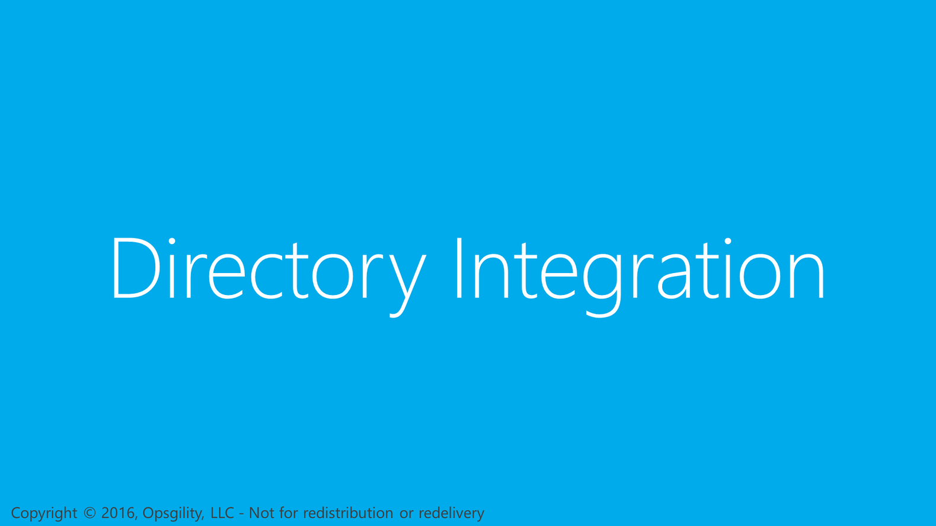
Directory Integration
Notes:
In this next section, I’m going to talk about how you can integrate an on-premises Windows Server active directory with your Azure Active Directory in Azure. This is a powerful feature that greatly simplifies identity and access management of cloud applications for your on-premises users.
Reference
http://technet.microsoft.com/library/jj573653

Slide 12
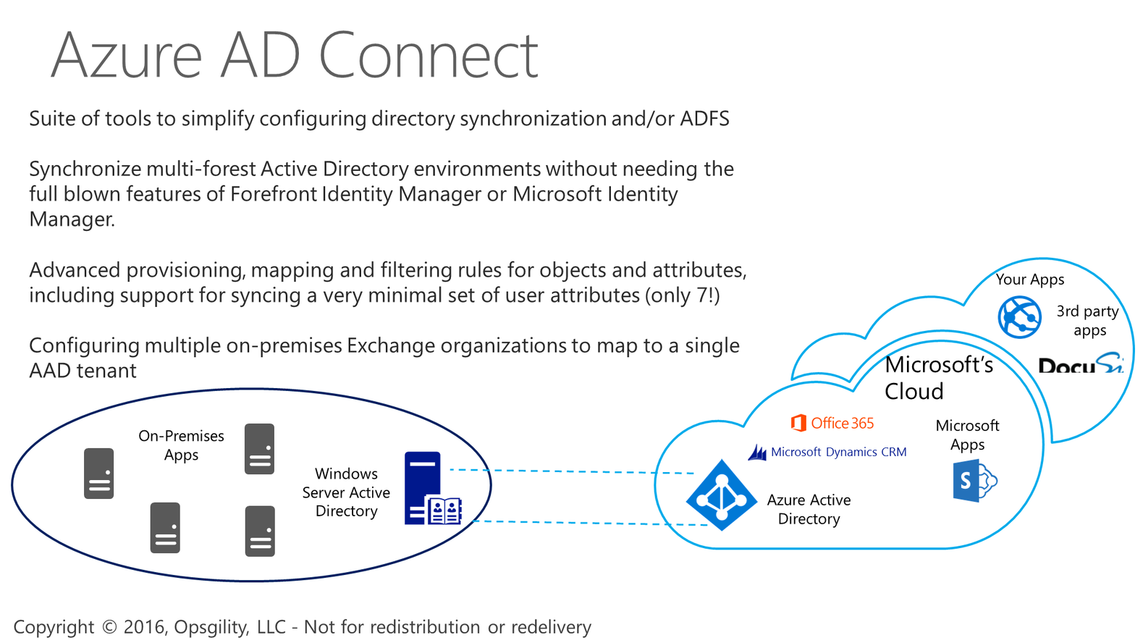
Azure AD Connect
Notes:
More information:
http://msdn.microsoft.com/en-us/library/azure/dn790204.aspx
Which attributes are sync’ed for which workload?
https://azure.microsoft.com/en-us/documentation/articles/active-directory-aadconnectsync-attributes-synchronized/#office-365-proplus

Slide 13
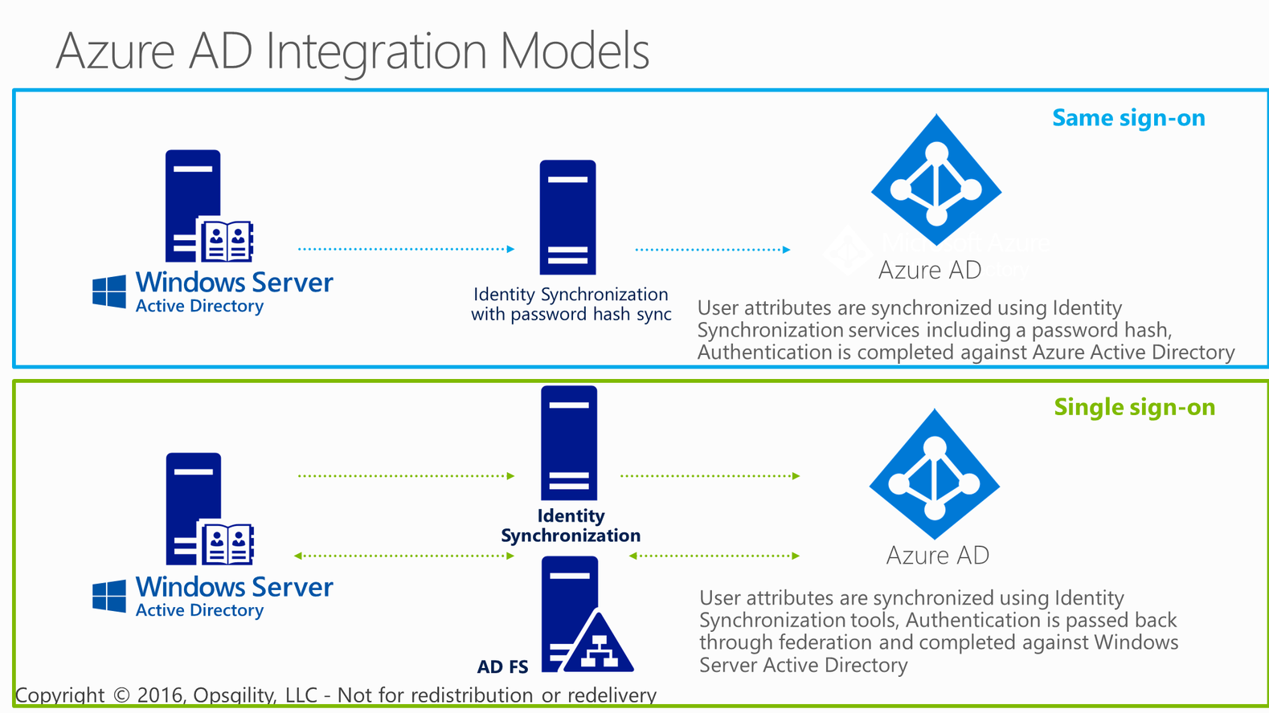
Azure AD Integration Models
Notes:
There are two techniques for integrating an existing Windows Server Active Directory with Azure AD
Option #1 is the simplest. Enable directory synchronization using AADSync (formerly DirSync.exe).
Option #2 requires setting up an ADFS environment. Attributes are synchronized to Azure AD using AADSync but actual authentication is completed against AD through ADFS.
The key reasons you would want to go with Azure AD + ADFS is:
Security requirement to authenticate against the on-premises domain
In an enterprise if you access an application hosted in Azure and you are logged into the domain you will be automatically logged in. Where with AD Synch services you will be prompted.

Slide 14
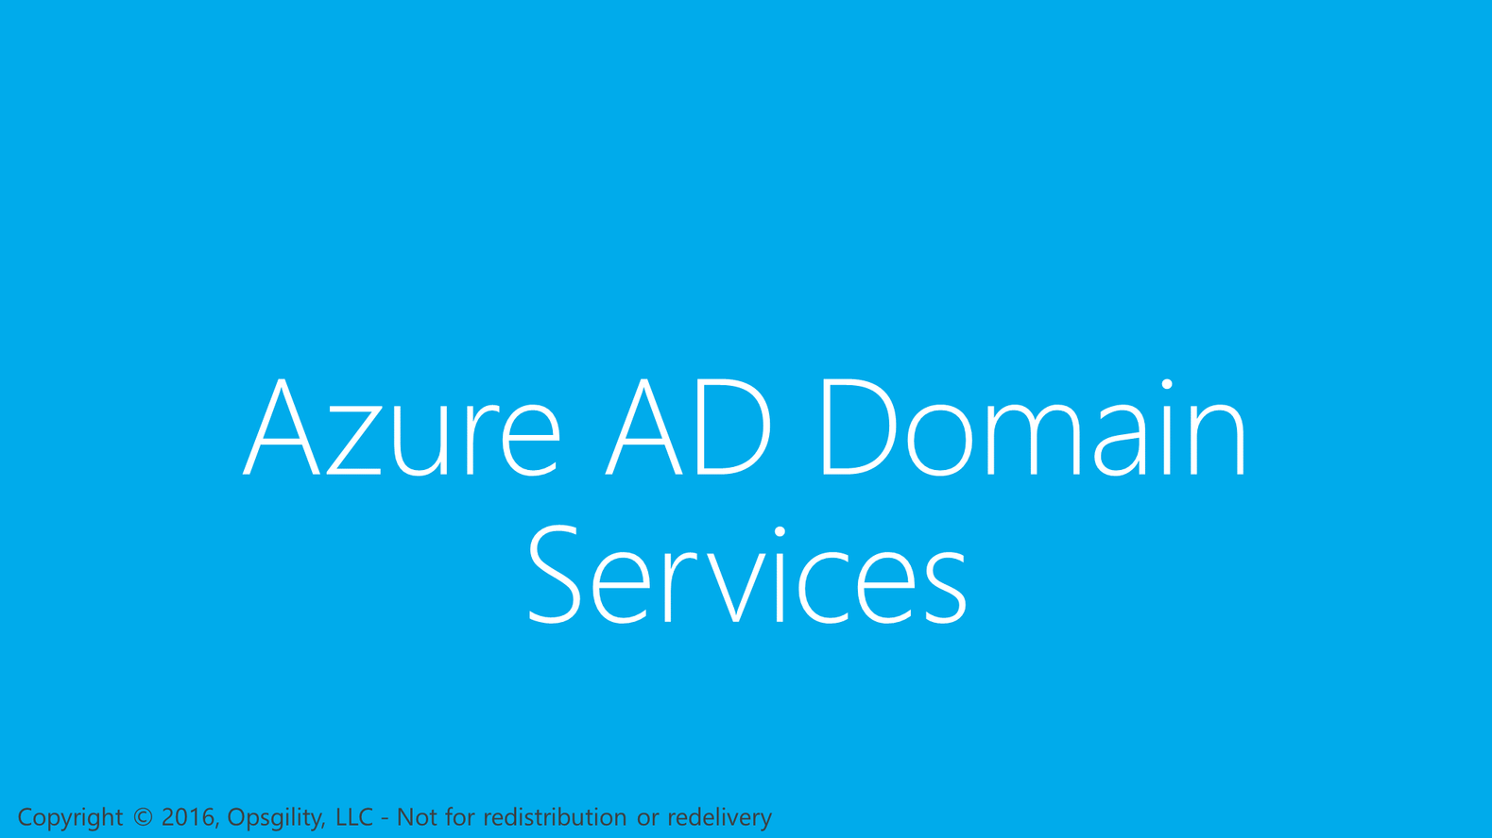
Azure AD Domain Services

Slide 15
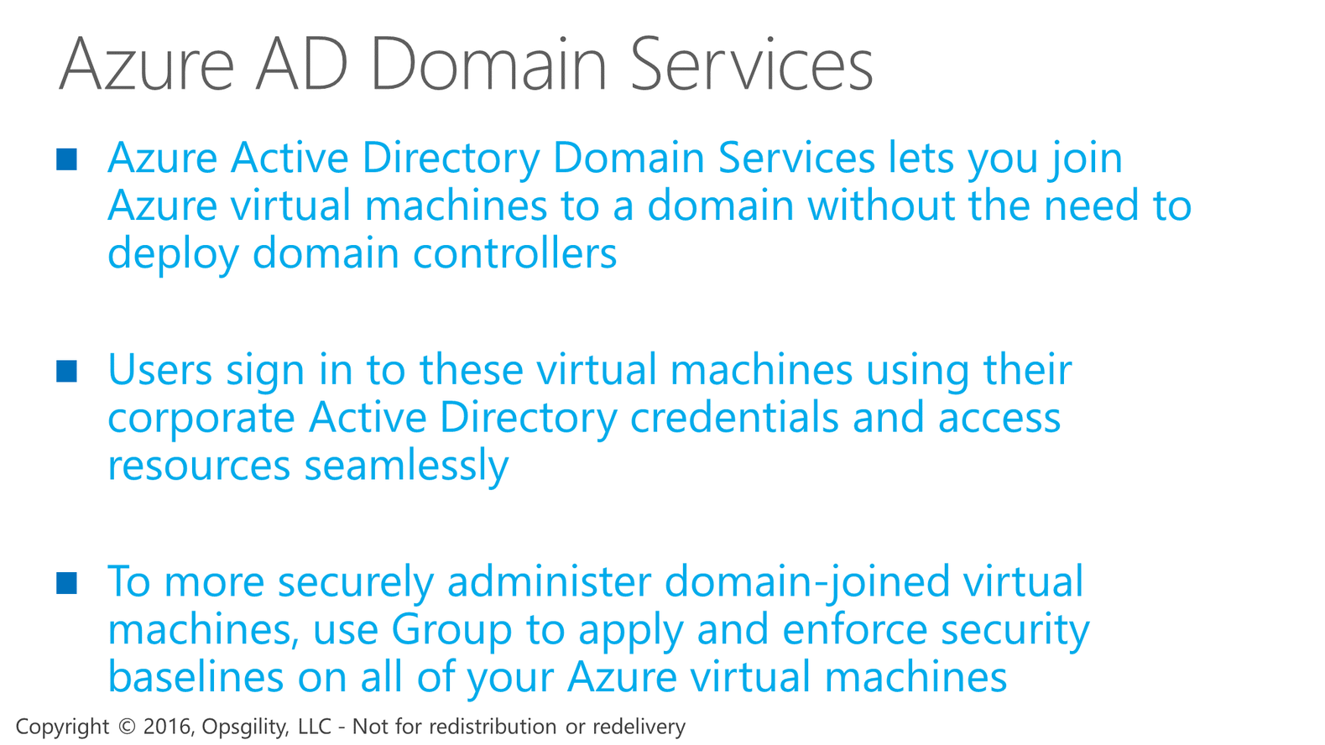
Azure AD Domain Services

Slide 16
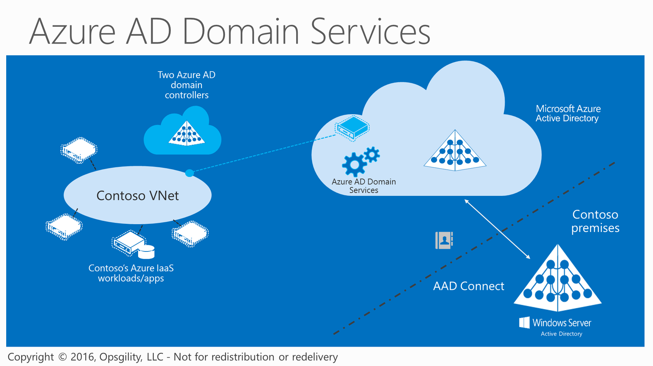
Azure AD Domain Services
Notes:
Azure Active Directory Domain Services lets you join Azure VMs to a domain synced from Azure AD without the need to deploy domain controllers. Your users can sign in to these virtual machines using their corporate Active Directory or Azure AD credentials and access server resources seamlessly.
Allows group policy for management – one each for user and computer
Limitations on the service today (as of 5/6/2016):
Can only create 1 domain serviced by AAD Domain Services for a single AAD directory
No PowerShell management currently
Only configurable in the classic portal
Cannot add domain controllers to the AAD Domain Services managed domain
Cannot connect to PaaS equivalent of a DC
No Enterprise or domain admin rights
Cannot extend the schema

Slide 17
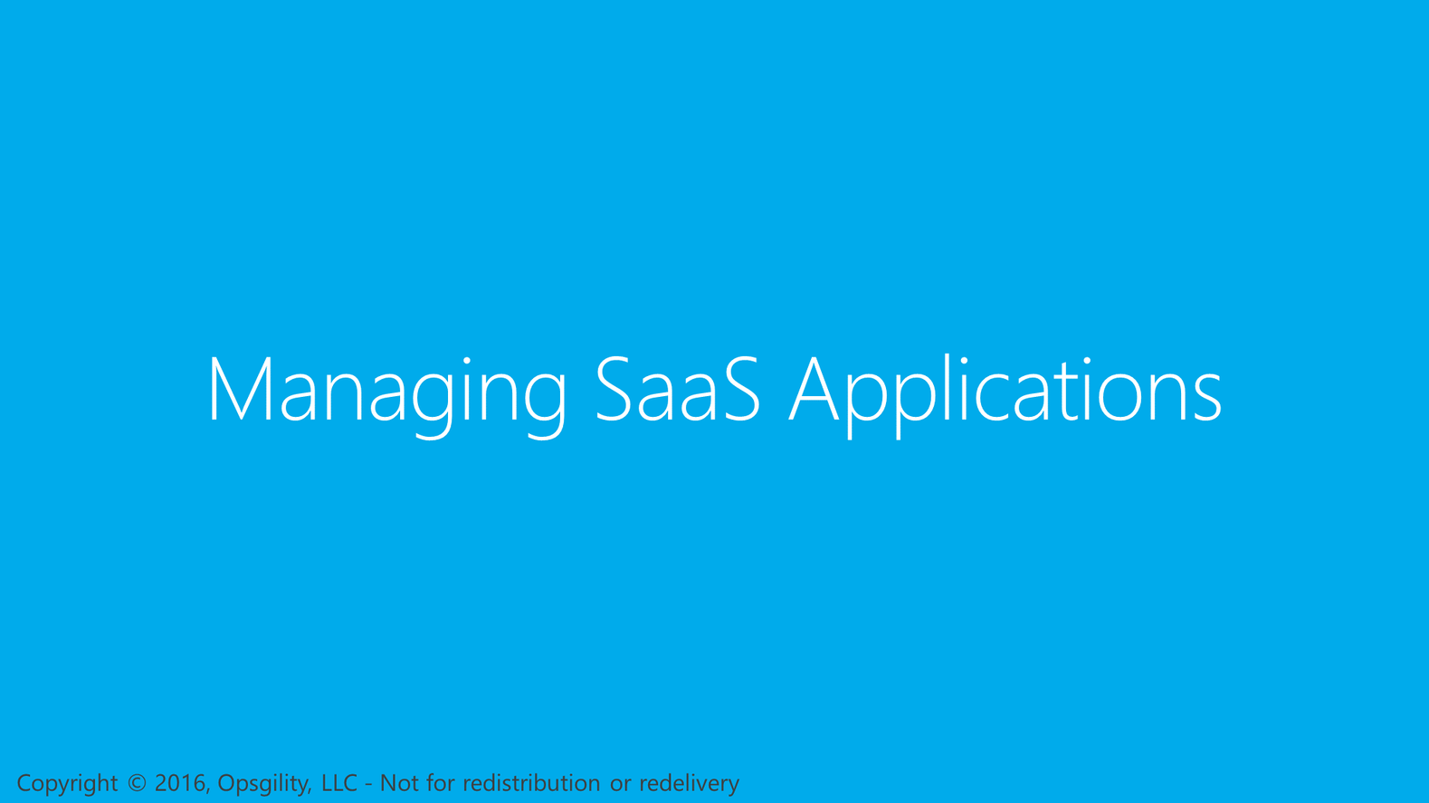
Managing SaaS Applications
Notes:
Let’s look now at how you can configure Application Access using Azure AD
Reference
http://technet.microsoft.com/en-us/library/dn308590.aspx

Slide 18
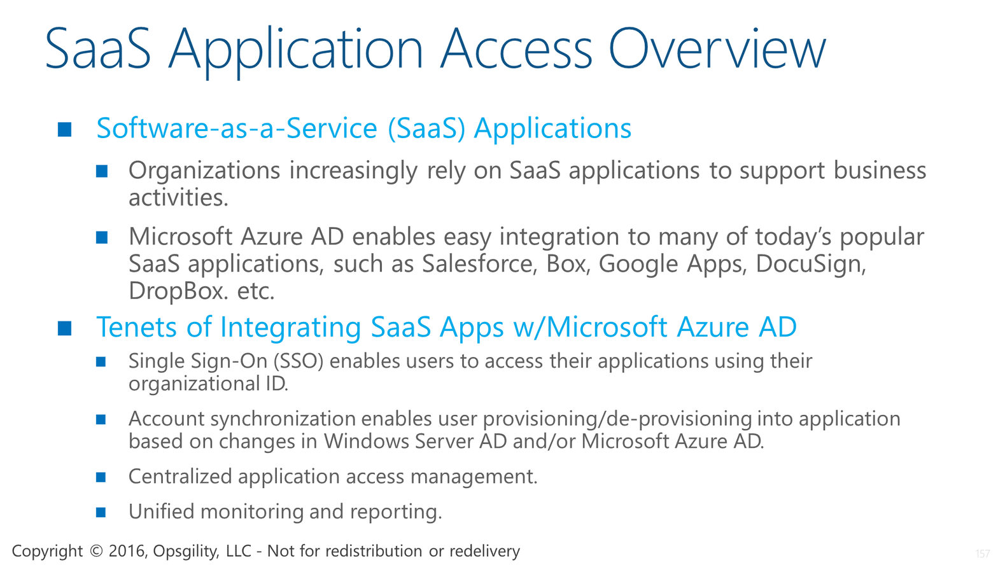
SaaS Application Access Overview
Notes:
Organizations increasingly rely on SaaS applications to support their business activities. And with Azure AD, it’s really easy to integrate these
applications into your environment and manage user access to them.
<CLICK>
The experience for integrating SaaS applications with Azure AD is influenced by 4 main tenets, the first being a first class single sign-on experience for users to access the applications they have been given access to.
<CLICK>
Next is account synchronization between an organization’s on-premises directory with their Azure Active Directory, whereby users are automatically provisioned or de-provisioned for applications as they are added to or removed from the om-premises directory.
<CLICK>
The Azure Management Portal provides a centralized location to manage application access for users ad security groups.
<CLICK>
Along with some very rich monitoring and reporting to gain critical visibility into application usage in the organization.

Slide 19
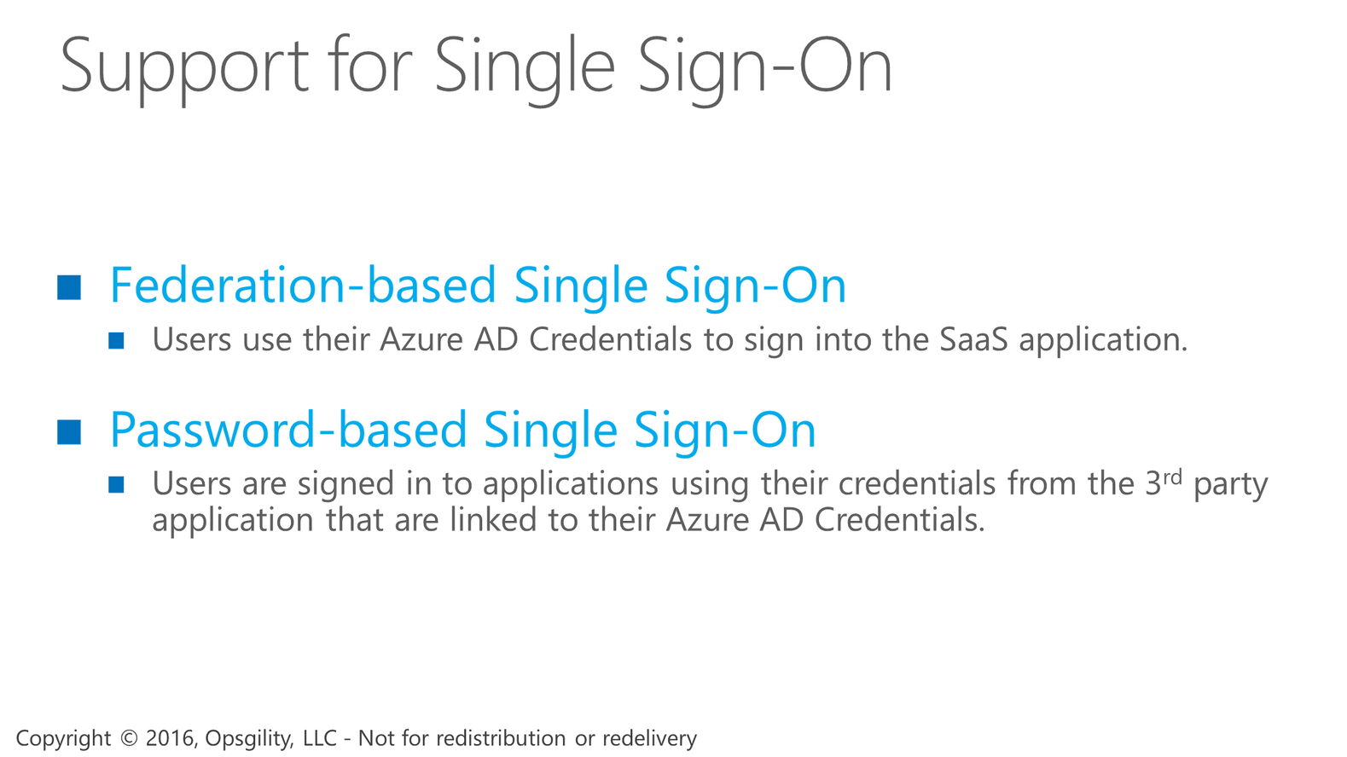
Support for Single Sign-On
Notes:
The support for single sign-on to 3rd party applications comes in two forms.
The first is Federation-based, where users are signed-in to their applications using their Azure AD credentials.
The other is Password-based, where users are signed in to their applications using their own personal credentials from the 3rd party application. In this scenario, the user’s credentials are securely stored in Azure AD and when the user accesses the application, those credentials are provided to the application to sign the user in.

Slide 20
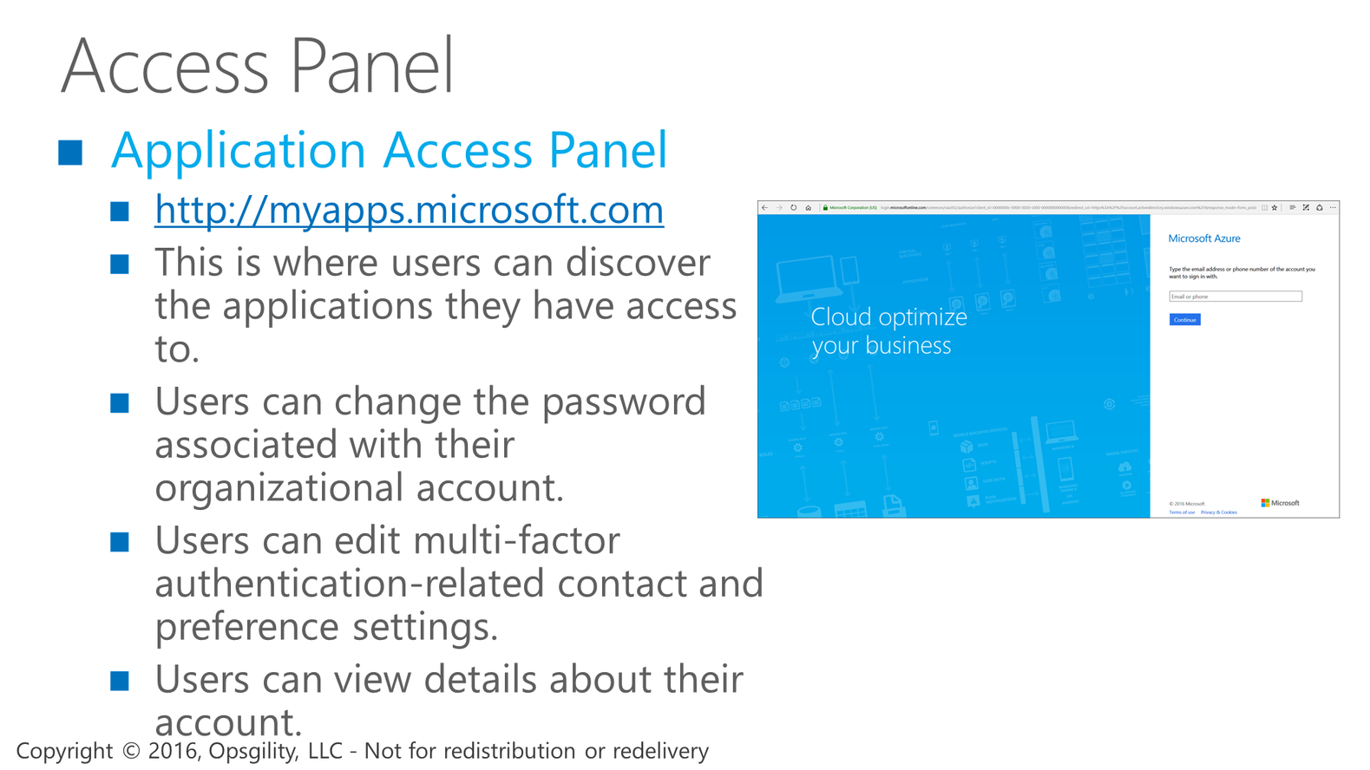
Access Panel
Notes:
As applications are configured for the organization, users can see and launch the applications they have been given access to using the Access Panel. This is a web-based portal for users and does not require individual users to have an Azure subscription.
<CLICK>
The access panel gives users a place to edit their passwords for applications configured with Password-based single sign on.
<CLICK>
They can also change preferences relating to multi-factor authentication settings. For example, the phone number to text verification codes to.
Reference
The Access Panel is a web-based portal that allows an end user with an organizational account in Microsoft Azure Active Directory to view and launch cloud-based applications to which they have been granted access by the Microsoft Azure AD administrator.
The Access Panel is separate from the Microsoft Azure Management Portal and does not require users to have a Microsoft Azure subscription.

Slide 21
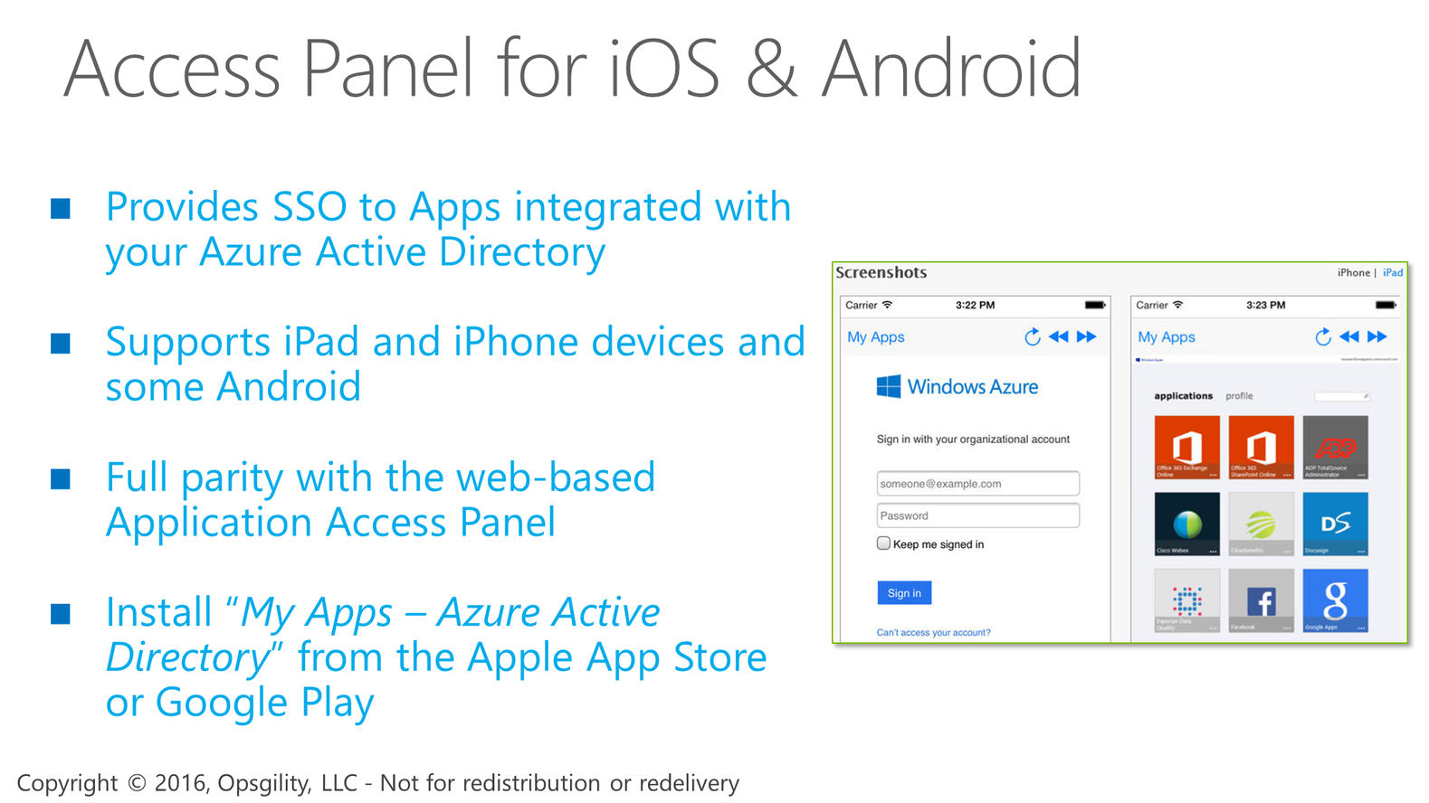
Access Panel for iOS & Android
Notes:
For users on iOS devices, the Access Panel is accessible from the MyApps application for iOS. This provides an optimized single-sign-on experience for users accessing their cloud applications from an iPhone or iPad without installing any web browser extensions. Just look for MyApps –Azure Active Directory in the Apple Store.
Reference
http://blogs.technet.com/b/ad/archive/2014/03/20/my-apps-sso-app-launcher-for-ios-now-available.aspx

Slide 22
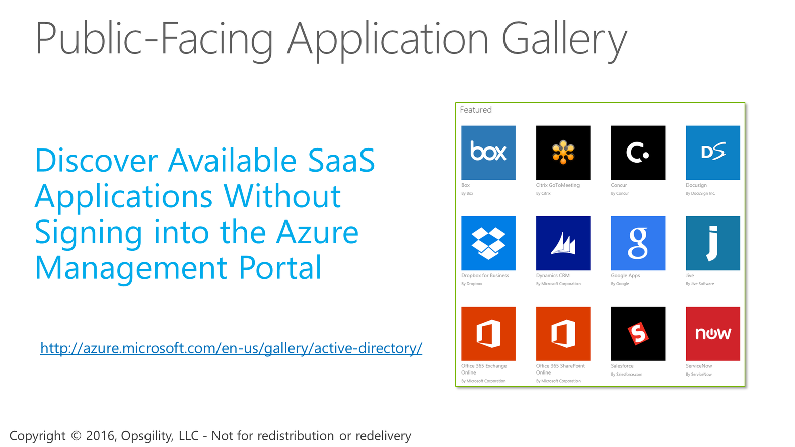
Public-Facing Application Gallery
Notes:
If you want to see all the applications that are available in the application gallery, there is a handy link at the bottom of the screen where you can discover the hundreds of applications available. And, you don’t need an Azure Subscription to access it.
Reference
http://blogs.technet.com/b/ad/archive/2013/11/25/new-public-facing-app-gallery-site.aspx

Slide 23
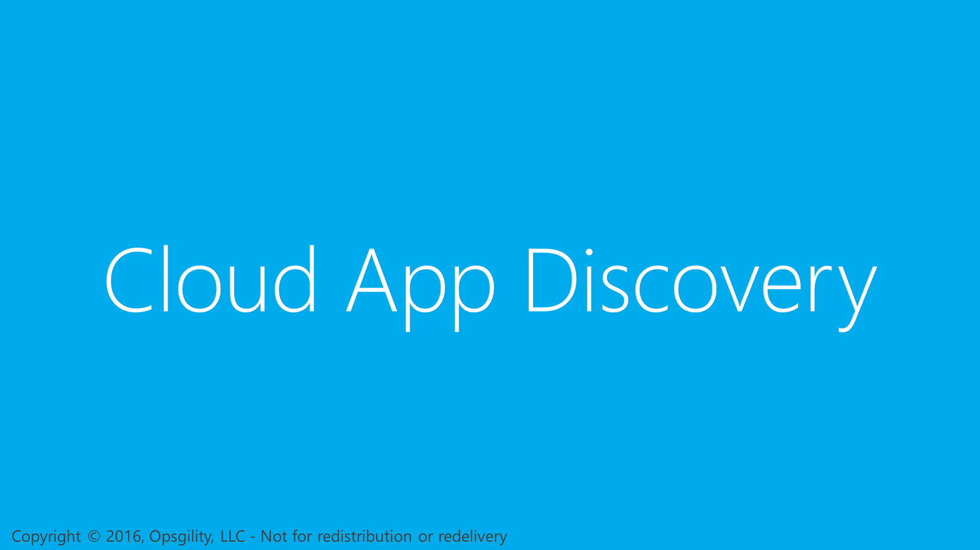
Cloud App Discovery
Notes:
Coming off of the application access topic, I want to talk briefly about another feature called Cloud App Discovery.
https://blogs.technet.microsoft.com/ad/2015/05/04/azure-cloud-app-discovery-ga-and-our-new-privileged-identity-management-service/

Slide 24
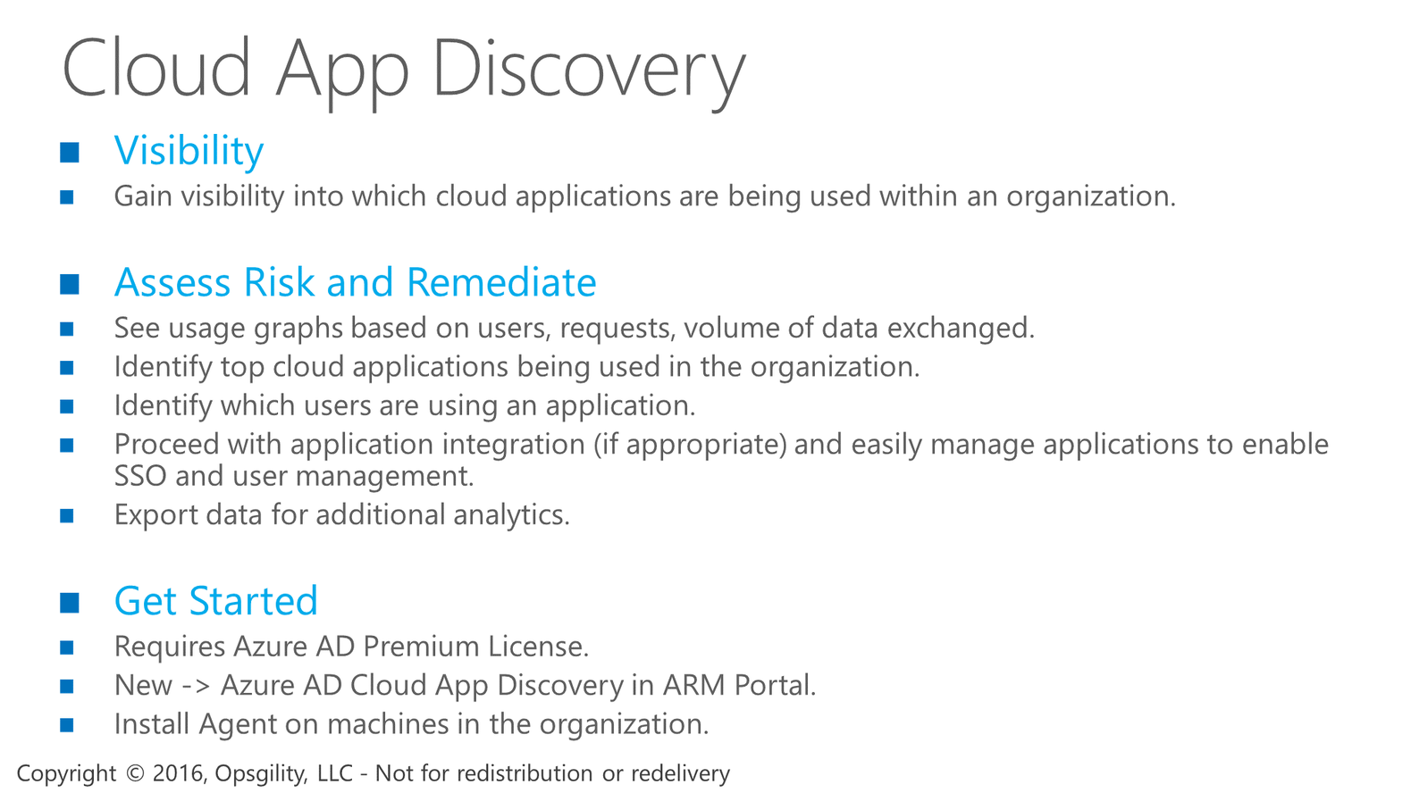
Cloud App Discovery
Notes:
With Cloud App Discovery, IT professionals can gain visibility into which cloud applications are in use in the organization. As part of the service, you can see usage graphs pinpointing users, requests, and the volume of data exchanged. You can see what the top SaaS applications being used in the organization are. And then, make informed decisions to add (or not add) the application to your Azure AD.
It is an agent based solution. So, after you enable the feature, you will need to install it on the computers you want to monitor.

Slide 25
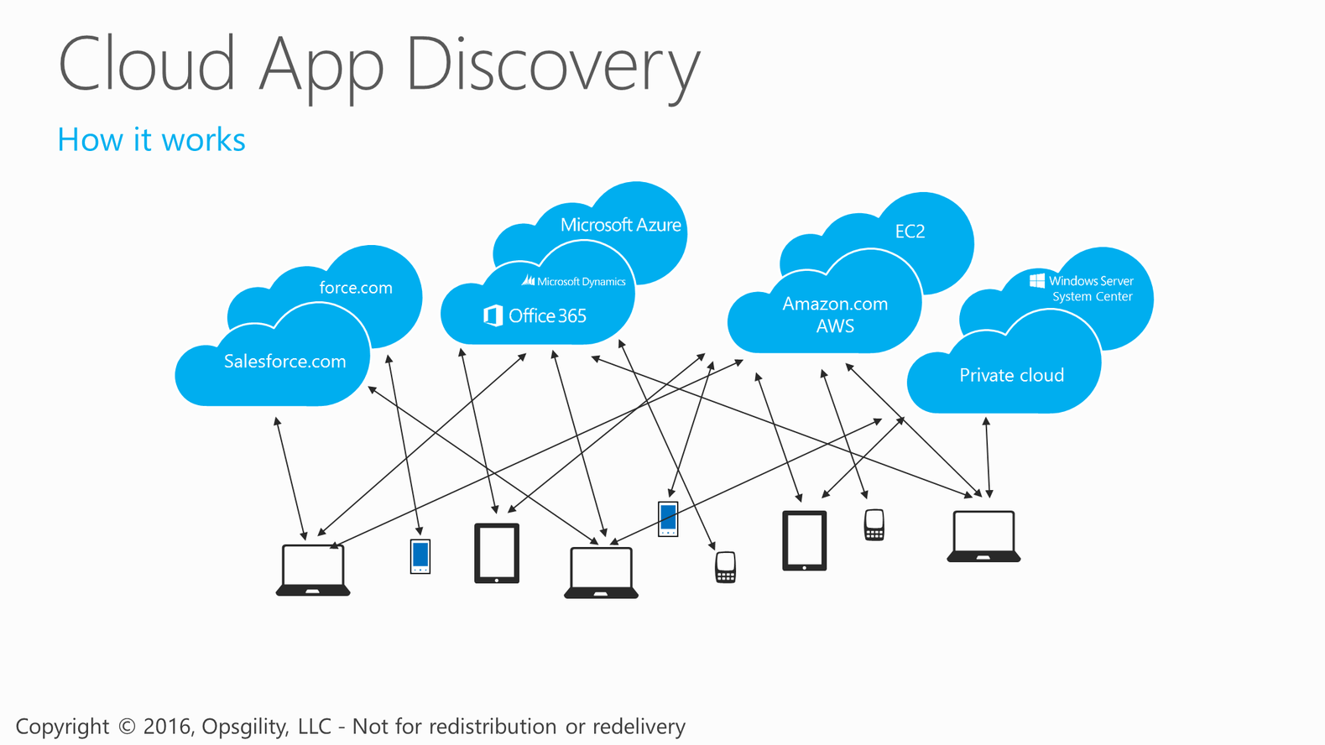
Cloud App Discovery
Notes:
As users are accessing various SaaS applications, the agent on their device will collect basic information about the application being accessed and the amount of data being exchanged.

Slide 26
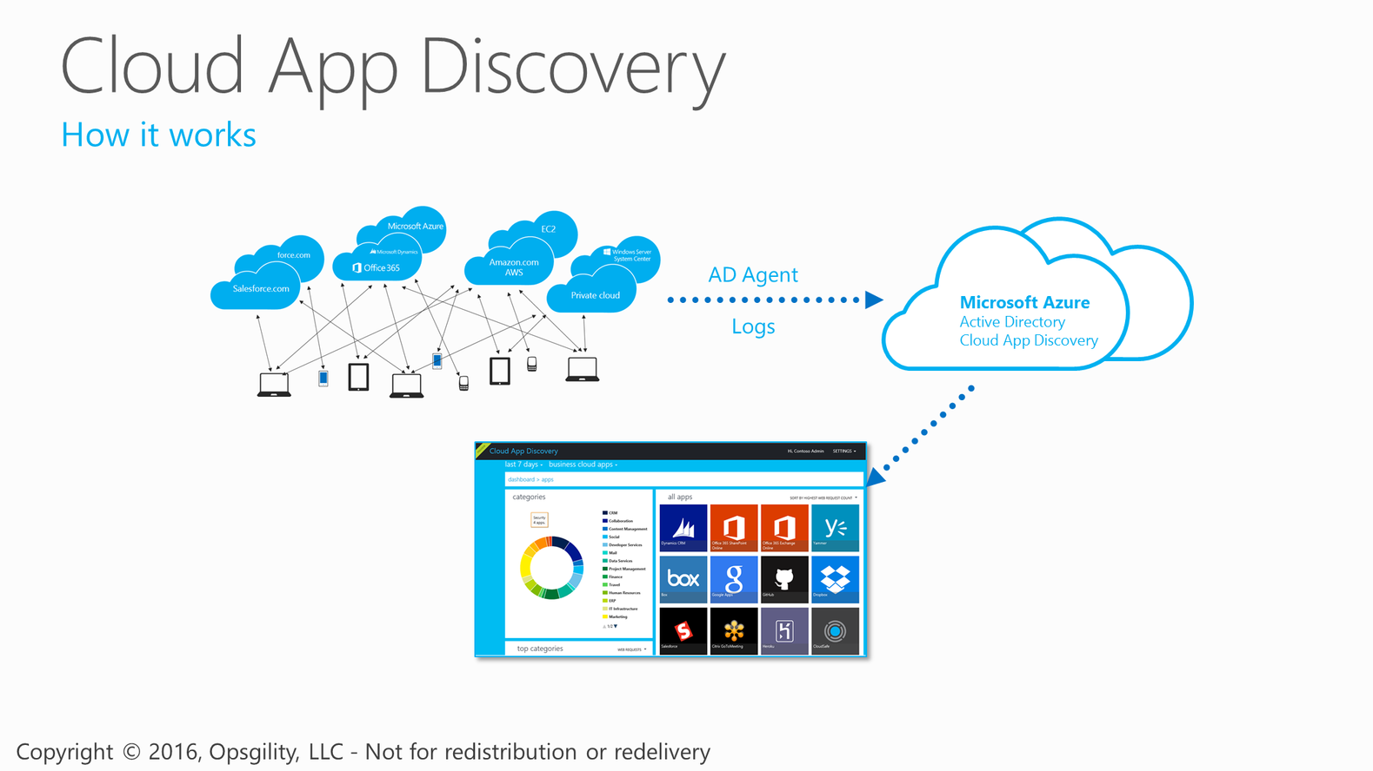
Cloud App Discovery
Notes:
<CLICK>
The agent stores the information in Azure.
<CLICK>
Using a portal, IT is able to access some rich reporting and graphs about the applications being used.

Slide 27
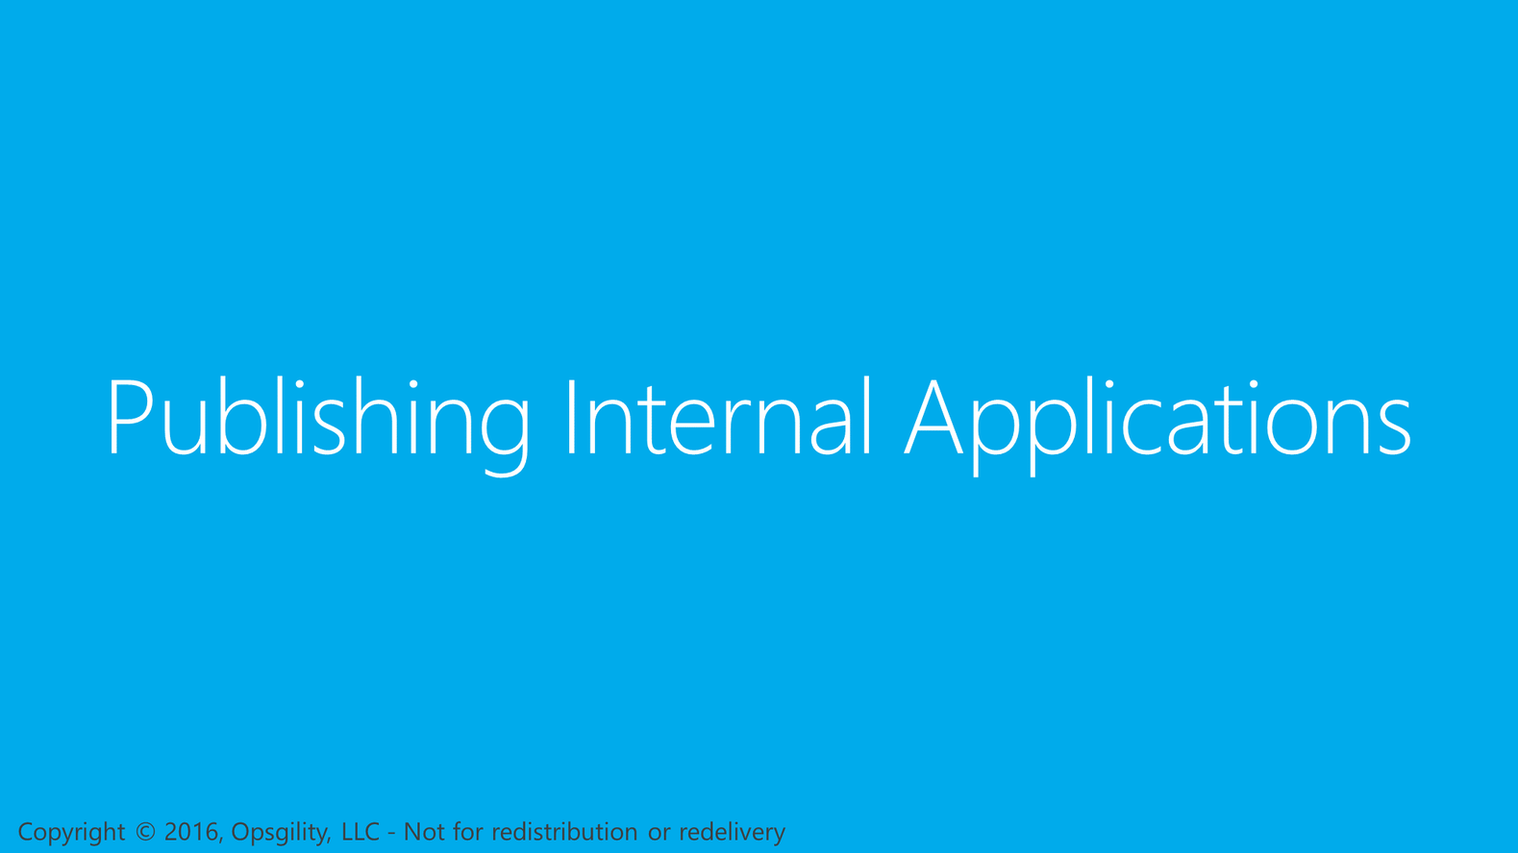
Publishing Internal Applications
Notes:
Let’s talk now about the Azure AD Application Proxy service.
Reference
http://channel9.msdn.com/events/TechEd/NorthAmerica/2014/PCIT-B327#fbid=

Slide 28
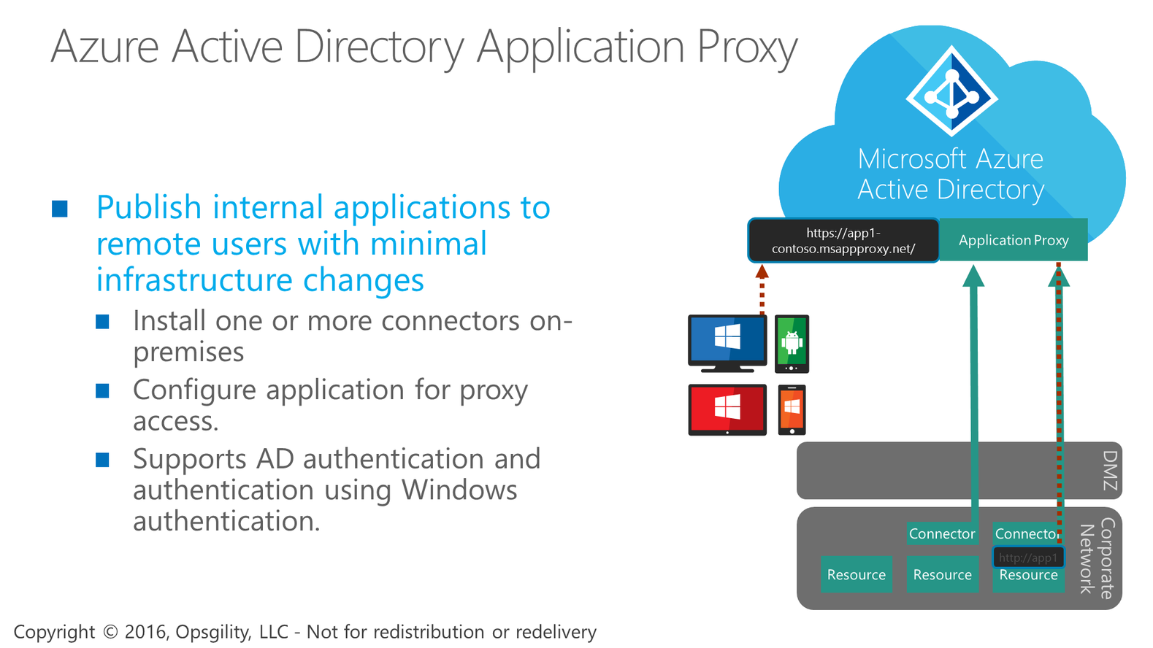
Azure Active Directory Application Proxy

Slide 29
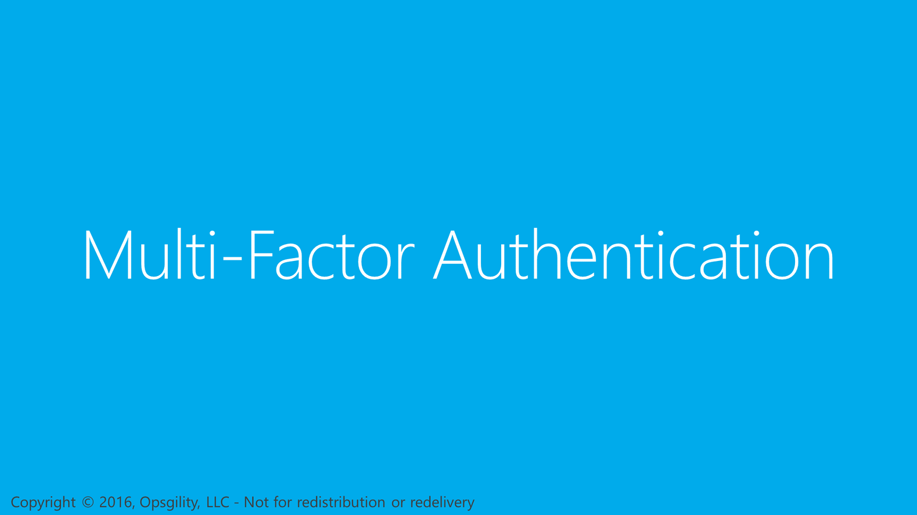
Multi-Factor Authentication
Notes:
Let’s tighten up security a little and talk about Multi-Factor Authentication.

Slide 30
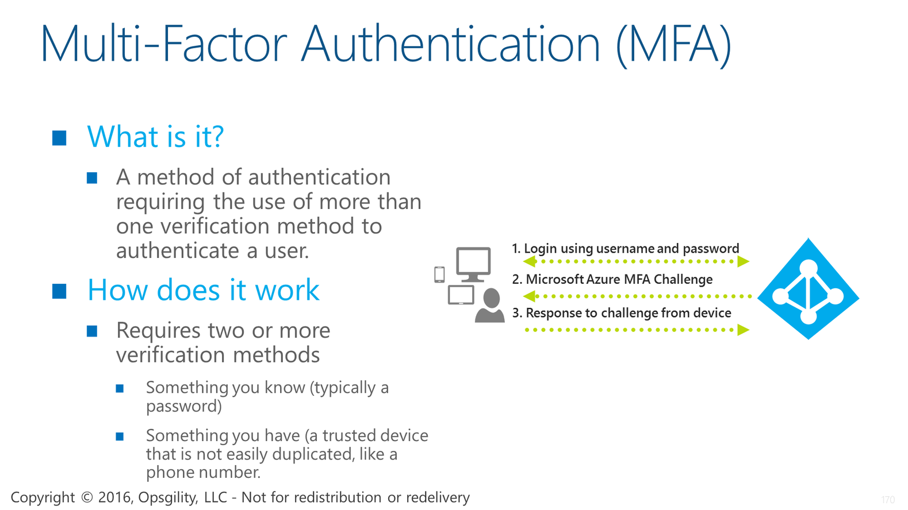
Multi-Factor Authentication (MFA)
Notes:
Multi-factor authentication simply means using more than one method to verify a user for authentication. It is also known as two factor authentication or “2FA”.
<CLICK>
The way it works is, during the first leg of authentication, you provide something you know, such as a password. After successfully authenticating with your credentials, the second leg begins where you are challenged, for example, to enter a security code sent to a device you have, such as a mobile phone. After entering the security code, the two-factor authentication is complete.
There can be other methods for verifying a user. The key here is that at least two are used.
Reference
http://technet.microsoft.com/en-us/library/dn249471.aspx

Slide 31
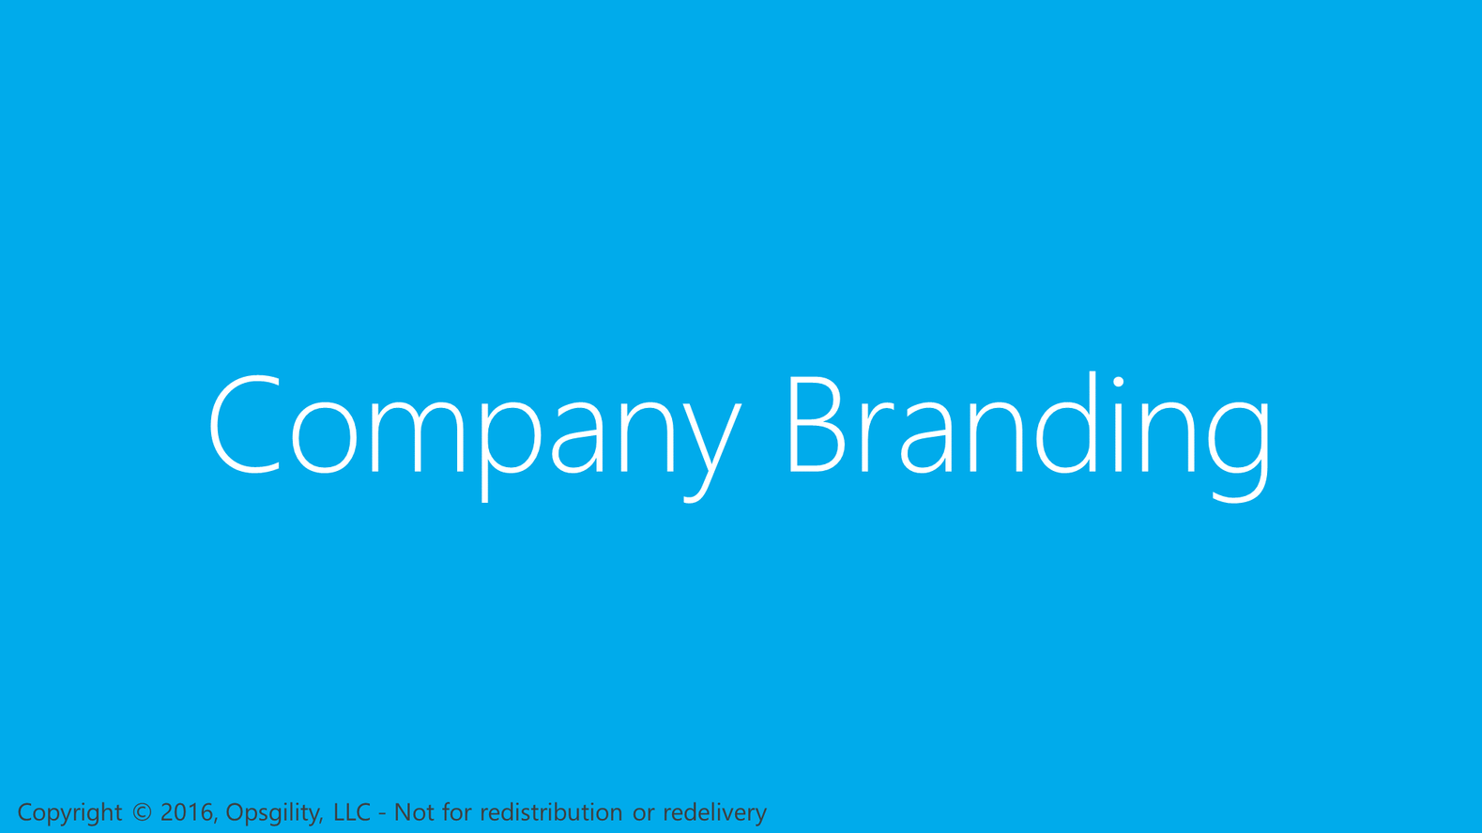
Company Branding
Notes:
In this next section I’m going to talk about how you can customize Azure AD with company branding.

Slide 32
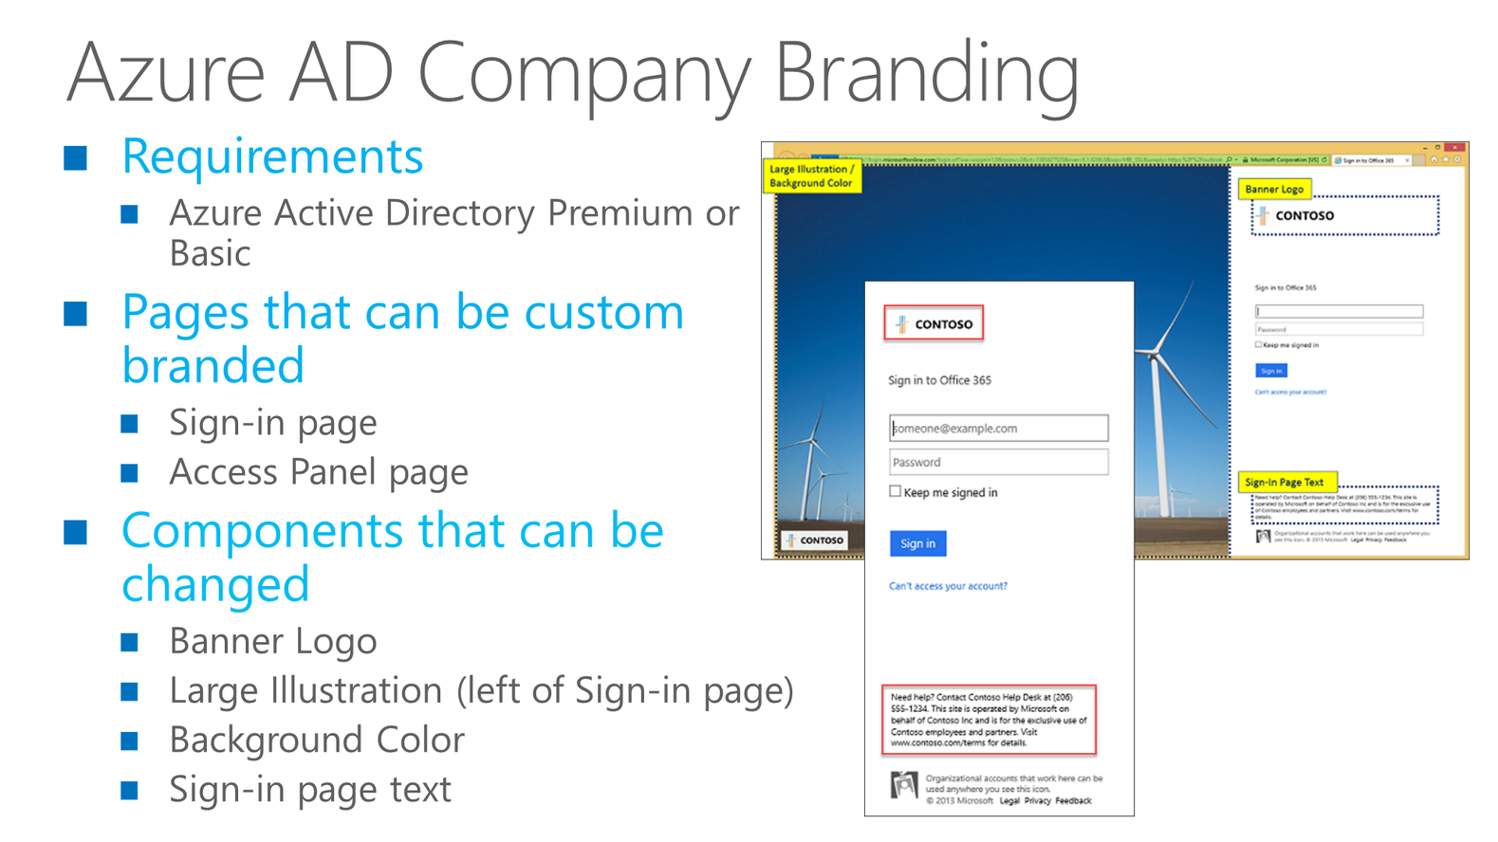
Azure AD Company Branding
Notes:
The custom branding features in Azure AD require the premium tier. This feature enables you to customize both the Sign-in page and Access Panel page for your users in a way that users can identify with their organization. For example, the banner logo and large illustration on the sign-in page can be changed to use a company logo and graphic. You can also add text to the sign-in page. A good use case for this is displaying help desk contact information such as a phone number or email address.
Reference
http://technet.microsoft.com/en-us/library/dn532270.aspx

Slide 33
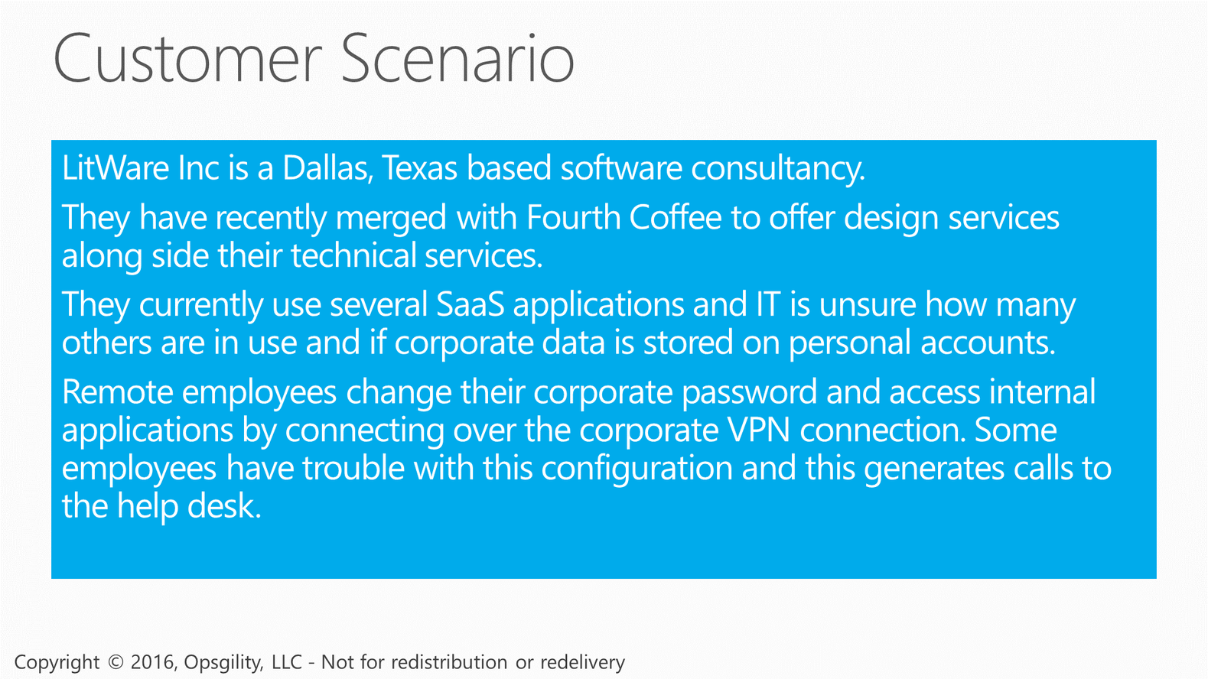
Customer Scenario

Slide 34
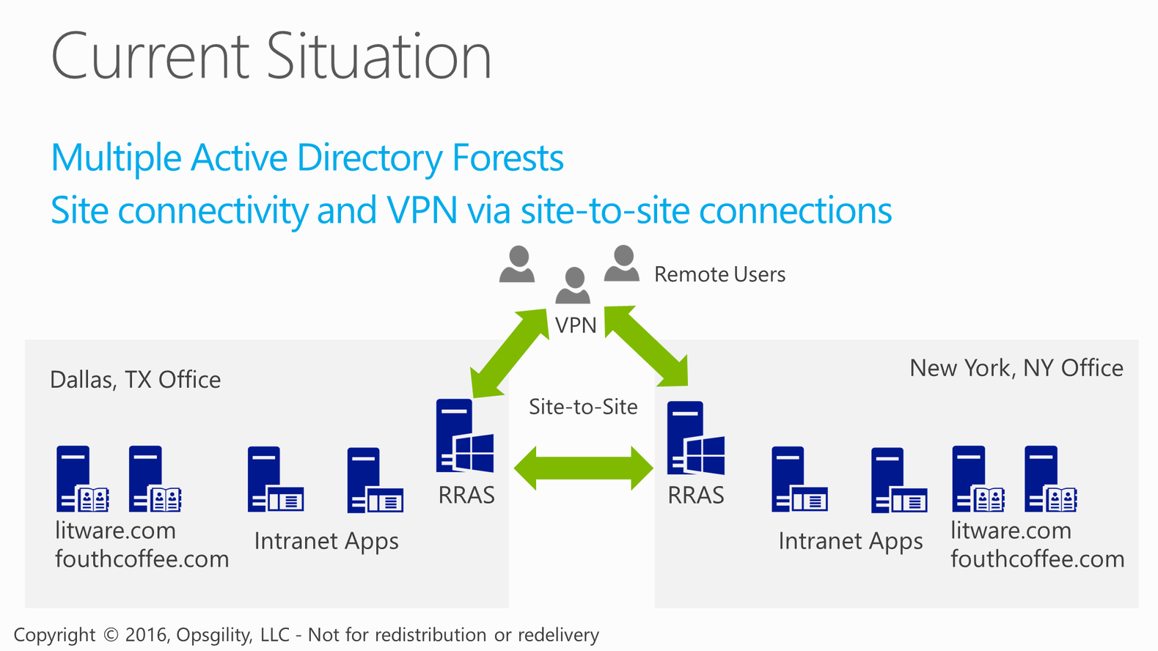
Current Situation

Slide 35
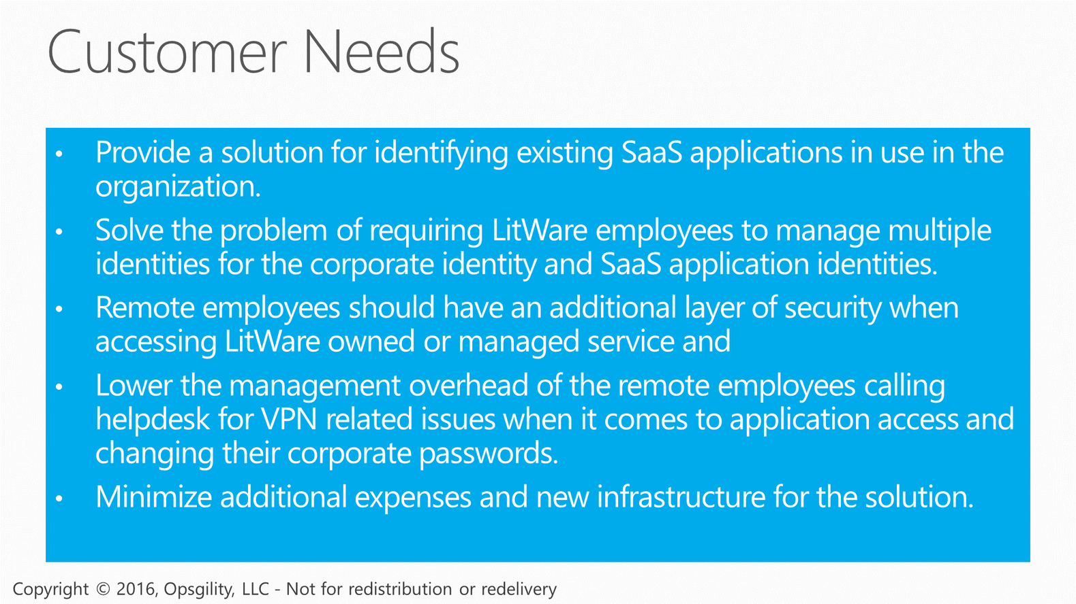
Customer Needs

Slide 36
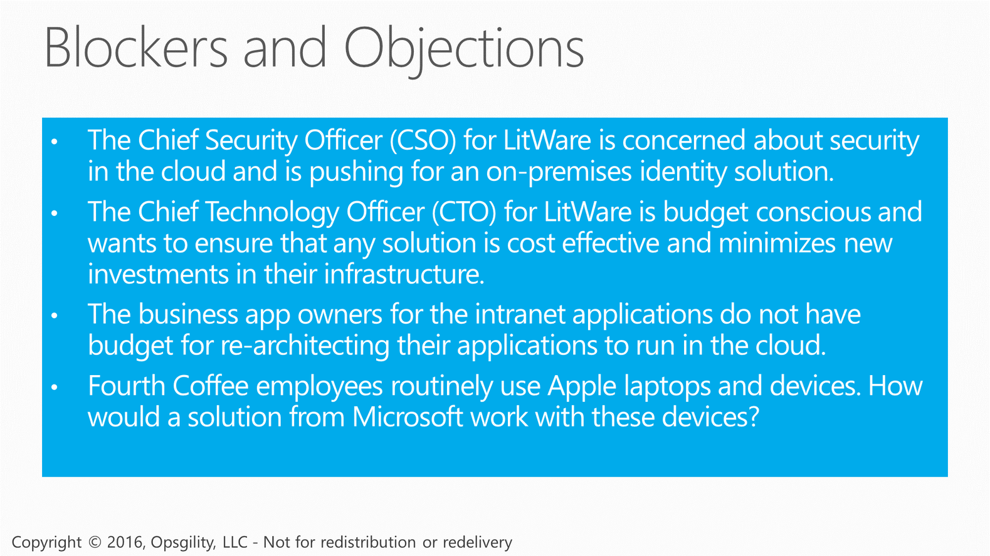
Blockers and Objections

Slide 37
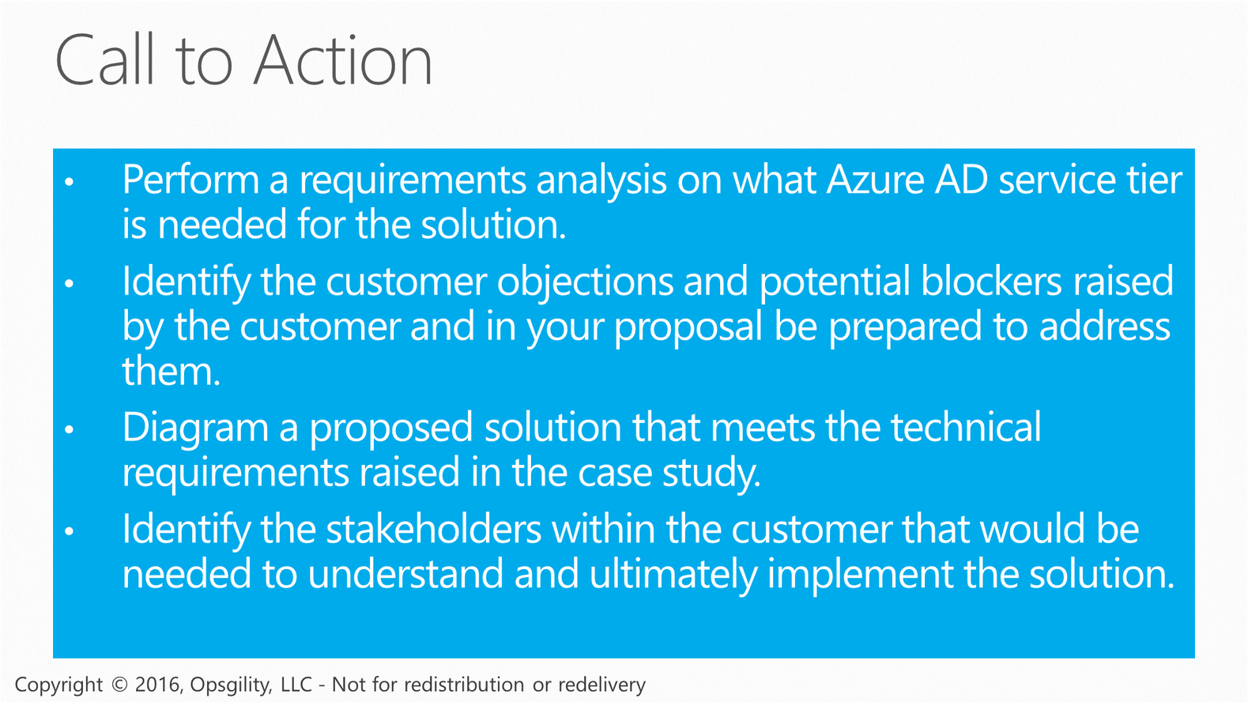
Call to Action

Slide 38
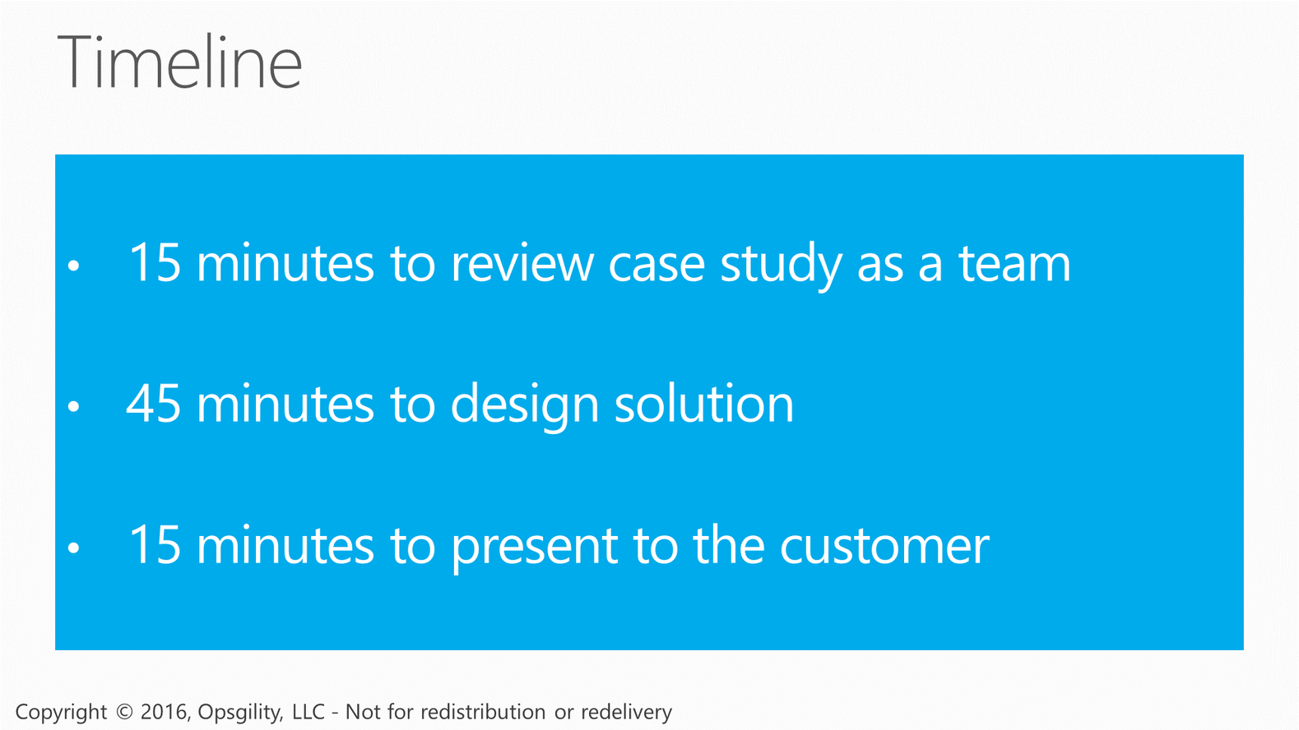
Timeline

Slide 39
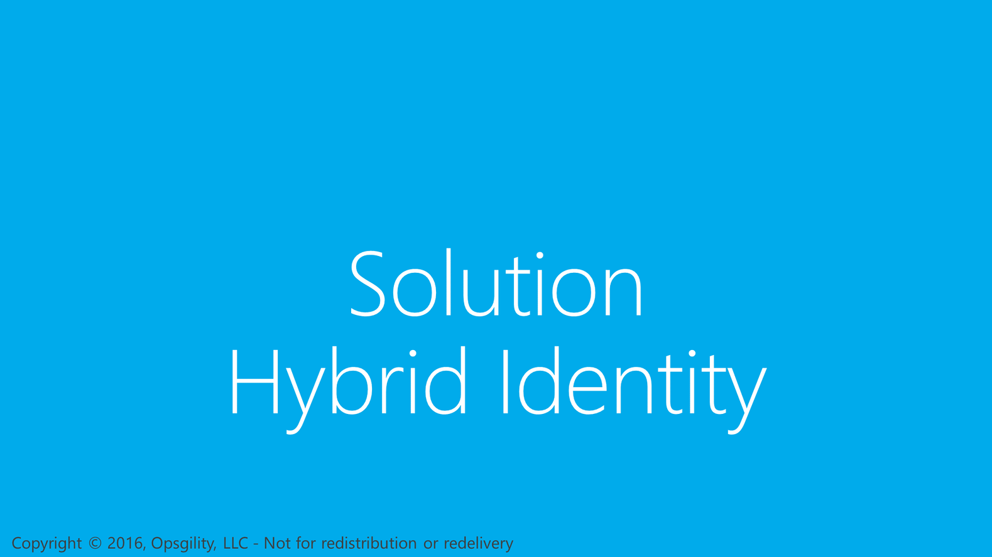
Solution Hybrid Identity

Slide 40
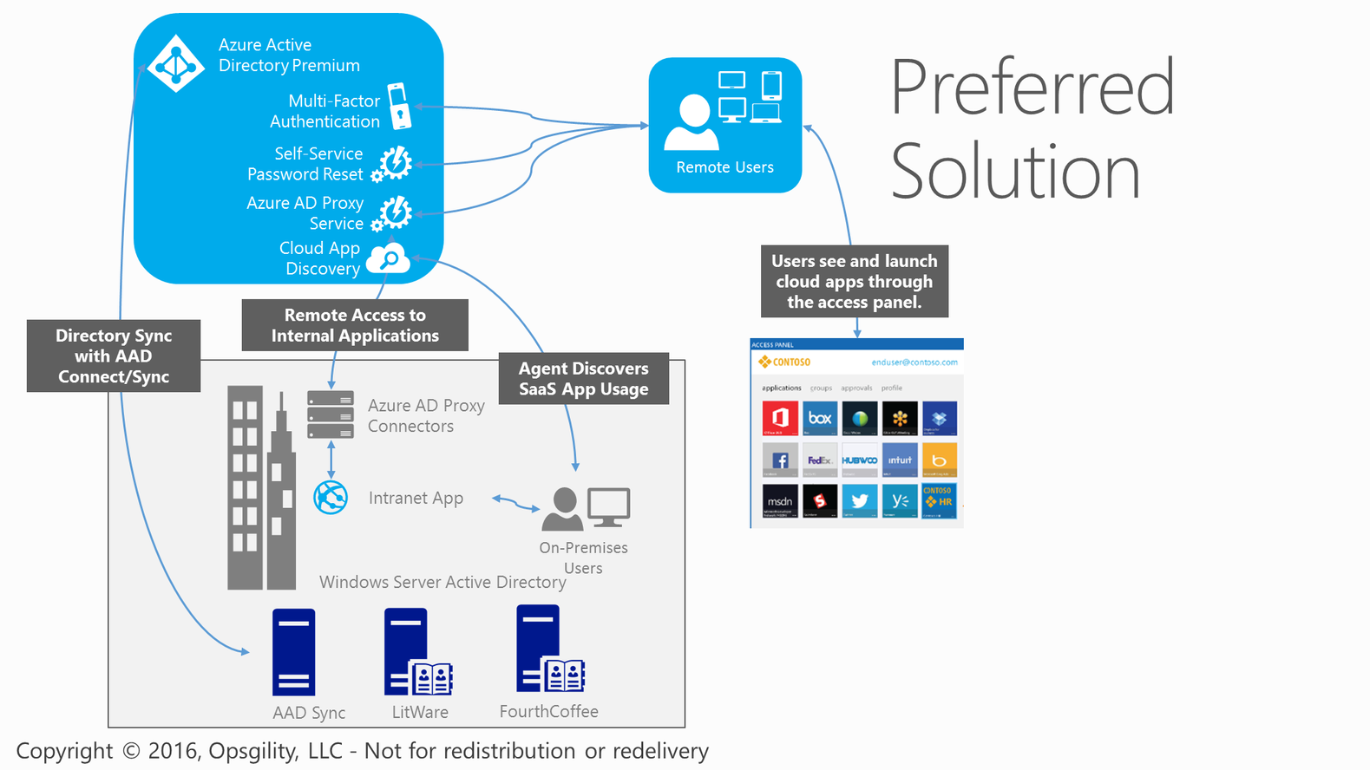
Preferred Solution

Slide 41
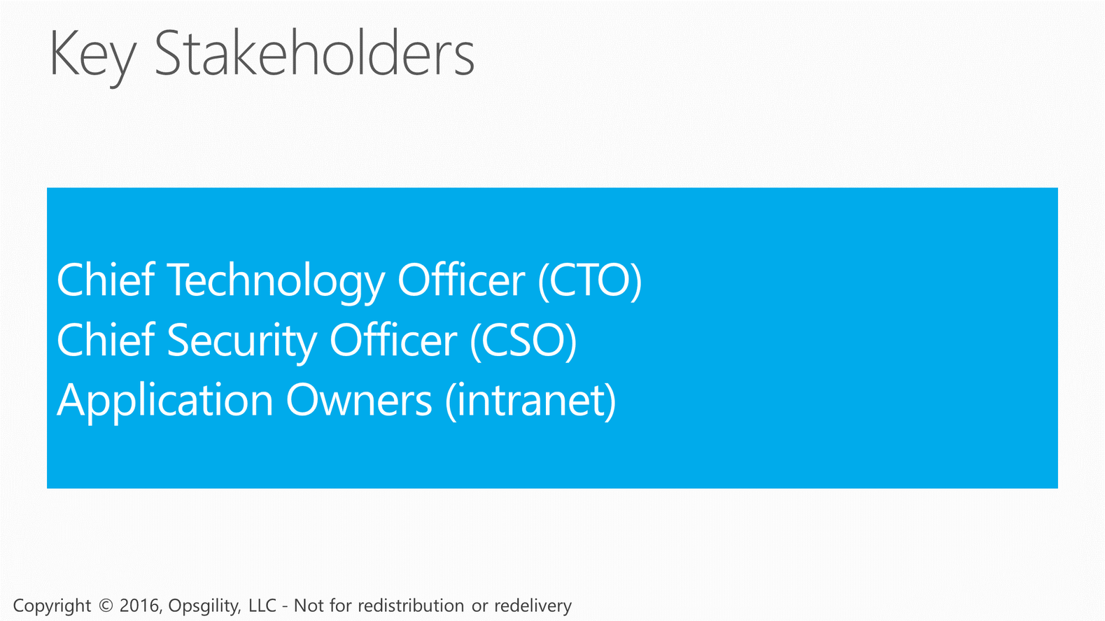
Key Stakeholders

Slide 42
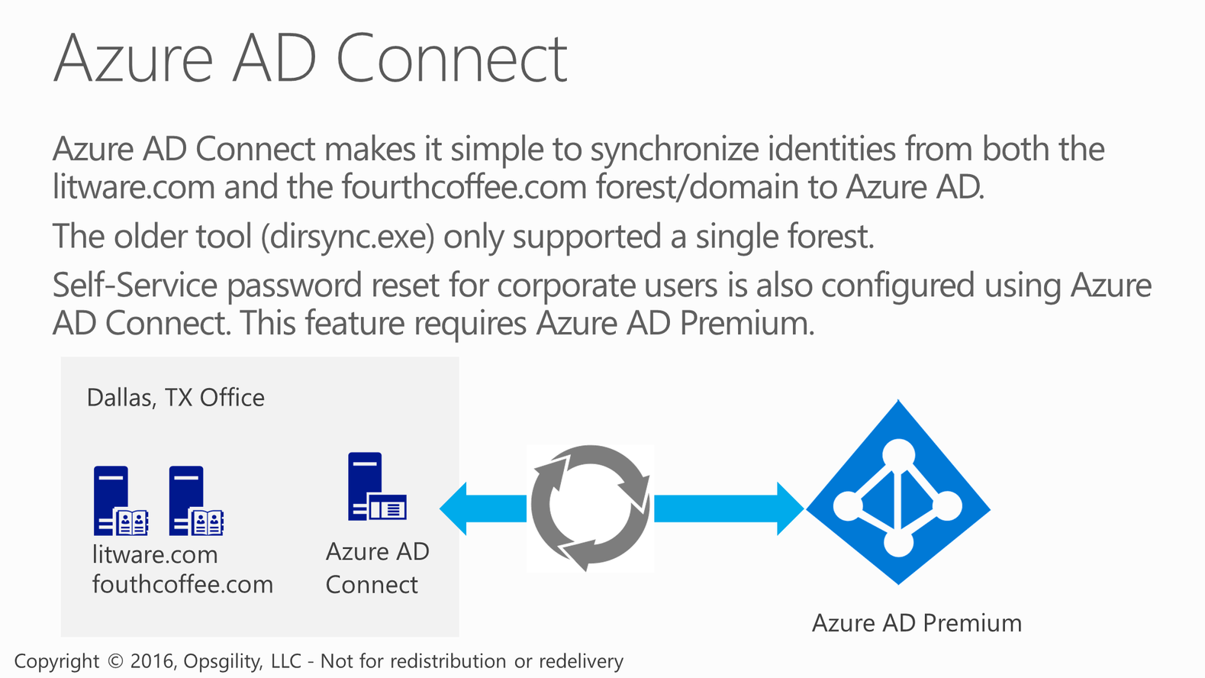
Azure AD Connect

Slide 43
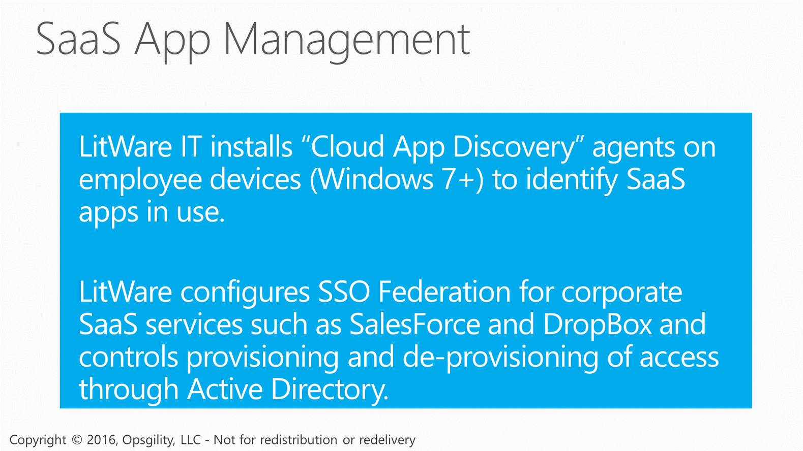
SaaS App Management

Slide 44
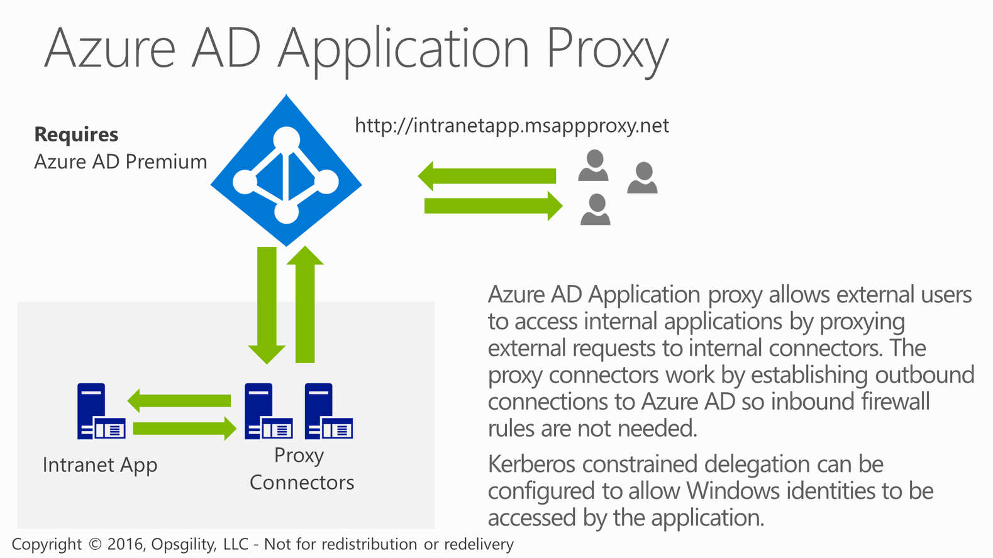
Azure AD Application Proxy

Slide 45
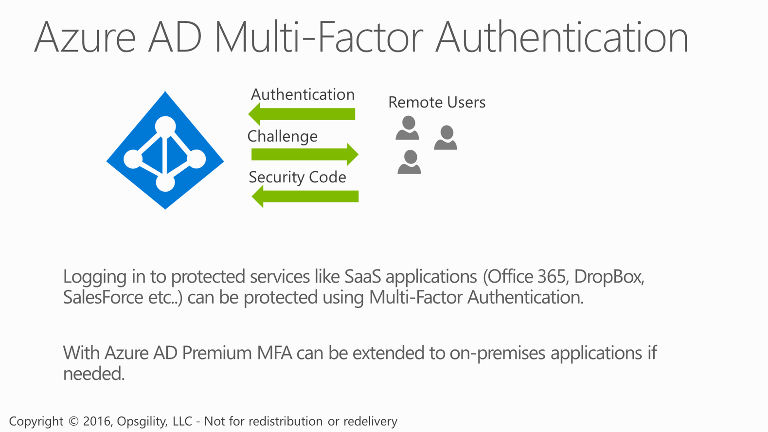
Azure AD Multi-Factor Authentication

Slide 46
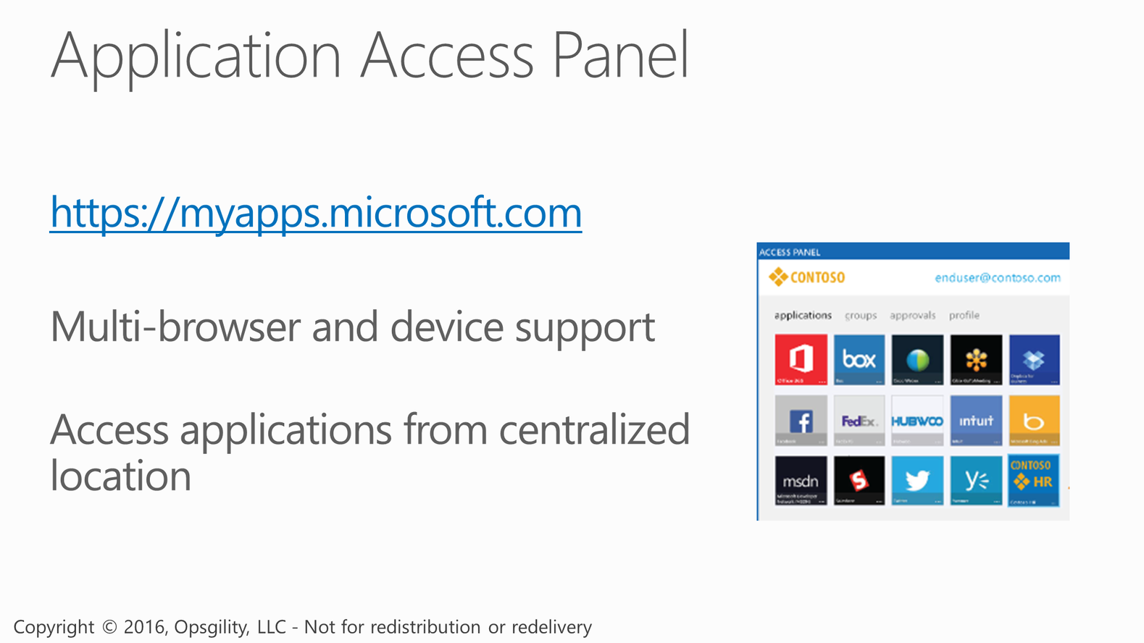
Application Access Panel

Slide 47
Blockers and Objections

Slide 49
Thank You

